Slide 1


Noida Institute of Engineering and Technology, Greater Noida
Module 4
Numerical Techniques
Unit: 4
Subject Name: Mathematics-III
Subject Code: AAS0301A
Dr. Kunti Mishra
Department of
Mathematics
B Tech 3rd Sem

Slide 2
Brief Introduction of Faculty
Dr. Kunti Mishra
Assistant Professor
Department of Mathematics
Qualifications :
M.Sc.(Maths), M. Tech.(Gold Medalist) in Applied and Computational Mathematics, Ph.D
Ph.D. Thesis : Some Investigations in Fractal Theory
International Journal Publications: 7
International Conference Papers: 7
Area of Interests: Fixed Point Theory, Fractals
Teaching Experience: 5 years

Slide 3

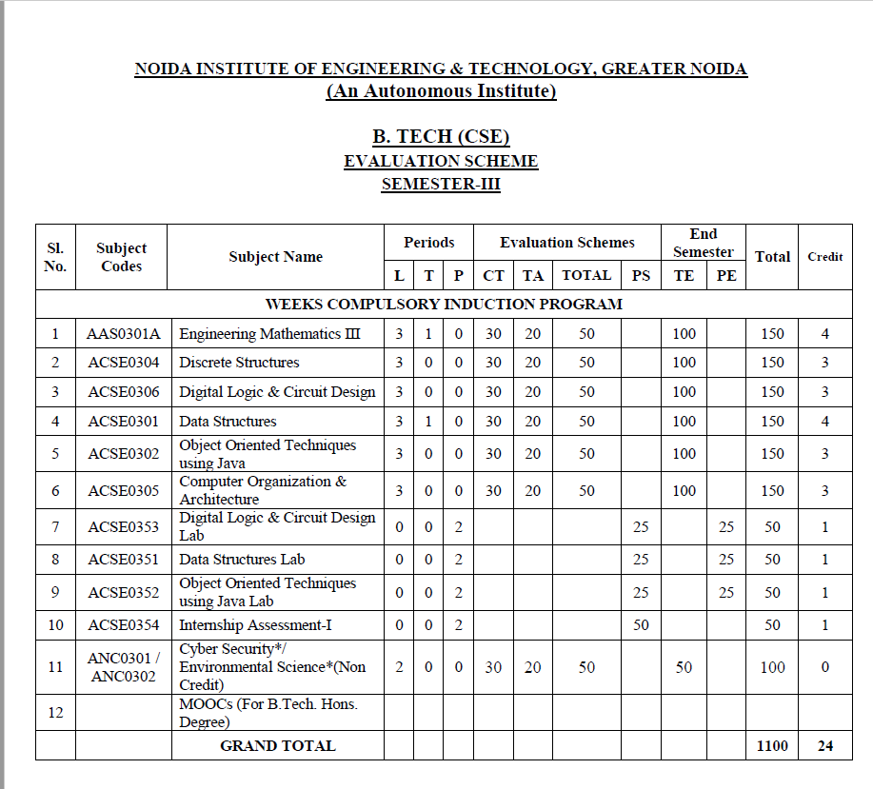
Evaluation Scheme

Slide 4


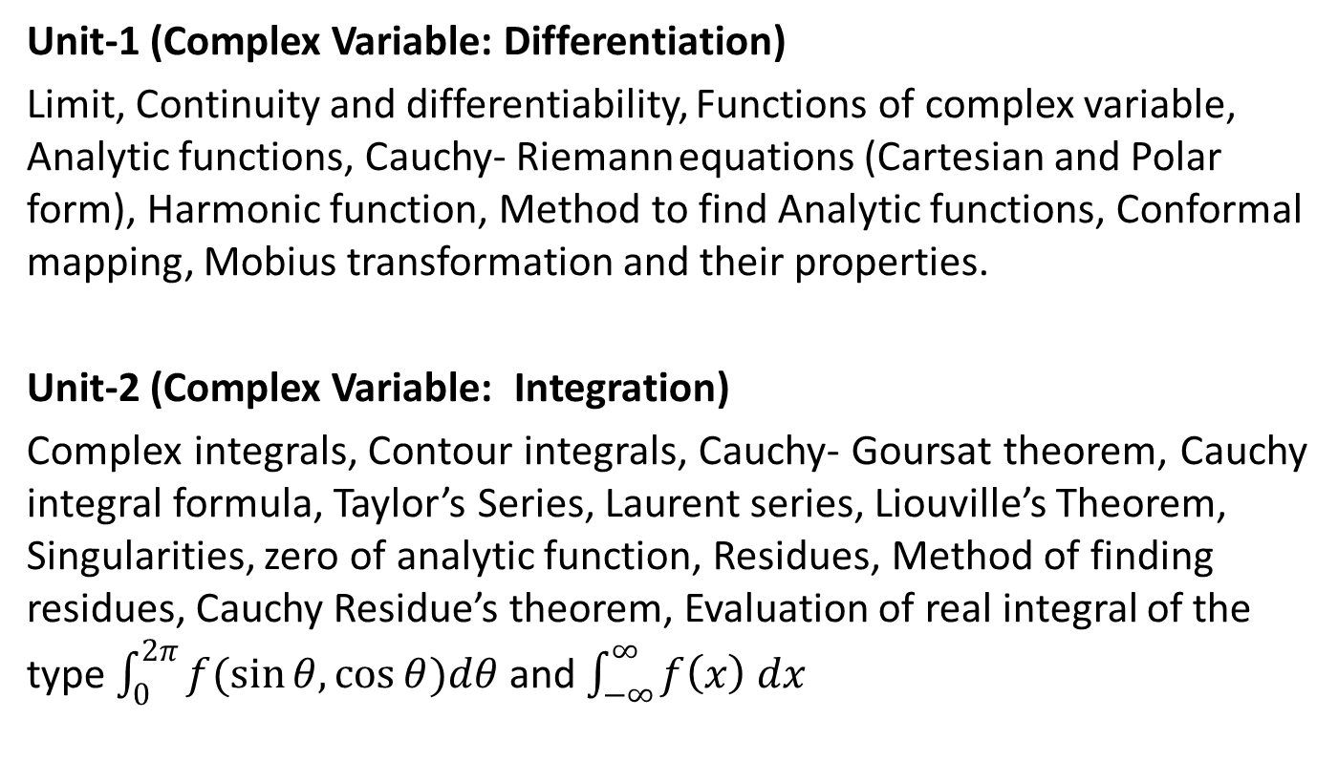
Syllabus
Unit-1 (Complex Variable: Differentiation)
Limit, Continuity and differentiability, Functions of complex variable, Analytic functions, Cauchy- Riemann equations (Cartesian and Polar form), Harmonic function, Method to find Analytic functions, Conformal mapping, Mobius transformation and their properties.
Unit-2 (Complex Variable: Integration)
Complex integrals, Contour integrals, Cauchy- Goursat theorem, Cauchy integral formula, Taylor’s Series, Laurent series, Liouville’s Theorem, Singularities, zero of analytic function, Residues, Method of finding residues, Cauchy Residue’s theorem, Evaluation of real integral of the type $\int_{0}^{2π}{f(\sin{θ,\cos{θ)dθ}}}$ and $\int_{−∞}^{∞}{f\left(x\right) dx}$

Slide 5
Syllabus
Unit-3 (Partial Differential Equation and its Applications)
Introduction of partial differential equations, Second order linear partial differential equations with constant coefficients. Classification of second order partial differential equations, Method of separation of variables for solving partial differential equations, Solution of one and two dimensional wave and heat conduction equations.
Unit-4 (Numerical Techniques)
Error analysis, Zeroes of transcendental and polynomial equations using Bisection method, Regula-falsi method and Newton-Raphson method, Interpolation: Finite differences, Newton’s forward and backward interpolation, Lagrange’s and Newton’s divided difference formula for unequal intervals. Solution of system of linear equations, Crout’s method, Gauss- Seidel method. Numerical integration: Trapezoidal rule, Simpson’s one third and three-eight rules, Solution of 1st order ordinary differential equations by fourth-order Runge- Kutta methods.

Slide 6
Syllabus
Unit-5 (Aptitude-III)
Time & Work, Pipe & Cistern, Time, Speed & Distance, Boat & Stream, Sitting Arrangement, Clock & Calendar.

Slide 7
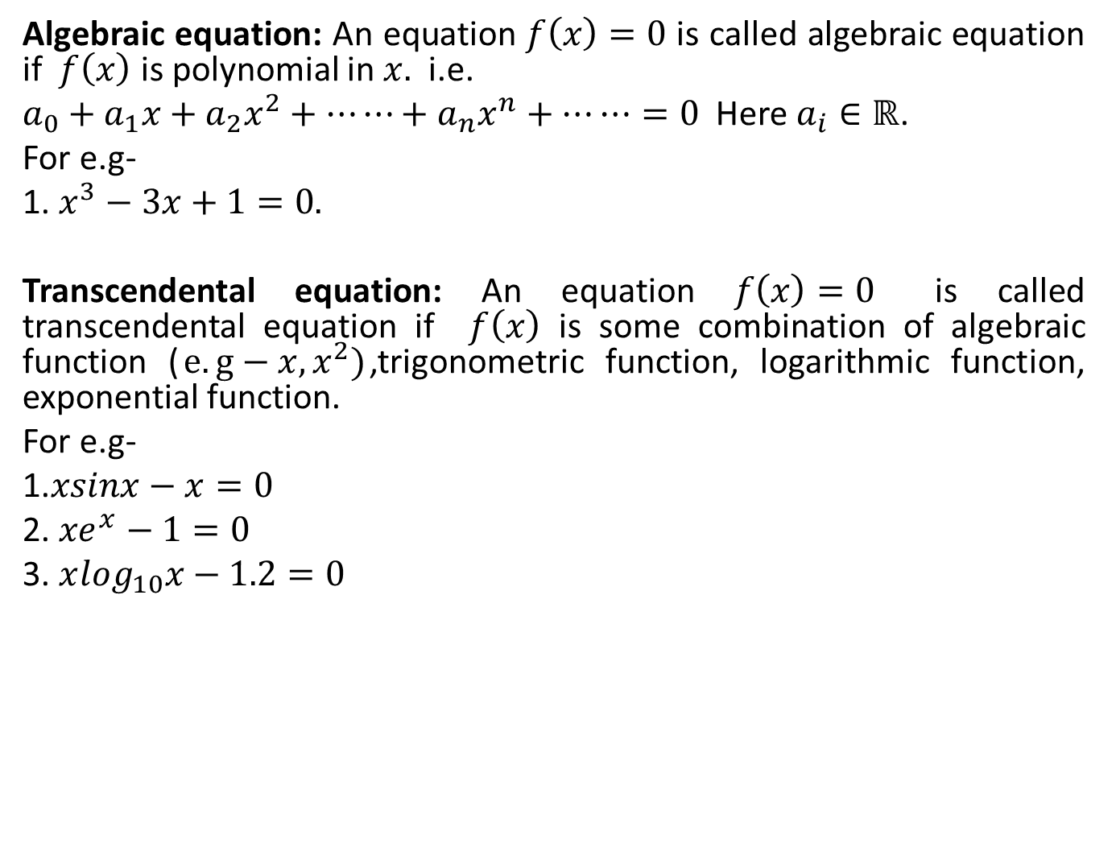
Zeroes of transcendental and algebraic equations[CO4]
Algebraic equation: An equation $f\left(x\right)=0$ is called algebraic equation if $f\left(x\right)$ is polynomial in $x.$ i.e.
$a_{0}+a_{1}x+a_{2}x^{2}+⋯⋯+a_{n}x^{n}+⋯⋯=0$Here $a_{i}∈ℝ$.
For e.g-
1. $x^{3}−3x+1=0.$
Transcendental equation: An equation $f\left(x\right)=0$ is called transcendental equation if $f\left(x\right)$ is some combination of algebraic function ($e.g−{x,x}^{2})$,trigonometric function, logarithmic function, exponential function.
For e.g-
1.$xsinx−x=0$
2. ${xe}^{x}−1=0$
3. $x\log_{10}x−1.2=0$

Slide 8
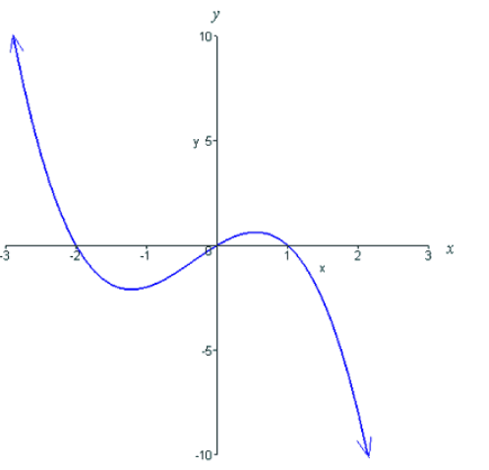

Zeroes of transcendental and polynomial equations[CO4]
Root/Zero- A point $x=a$ will be called a root of an equation $f\left(x\right)=0$ if $f\left(a\right)=0$ . Graphically, we can say where it cuts the $x$-axis.

Slide 9
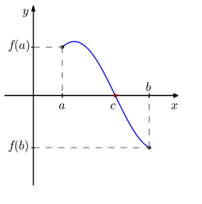

Zeroes of transcendental and polynomial equations[CO4]
To find the root of a equation numerically we find initial approximation by intermediate value theorem
Intermediate value theorem-If $f(x)$ is continuous on $\left[a,b\right]$ and $f(a)$ and $f(b)$ are of opposite sign i.e. $f\left(a\right).f\left(b\right)<0.$Then $f\left(x\right)$ has at least one root or odd number of roots on that interval.

Slide 10
Iterative method for finding root of an equation[CO4]
Bisection method
Regula-falsi method/method of false position
Newton Raphson method

Slide 11
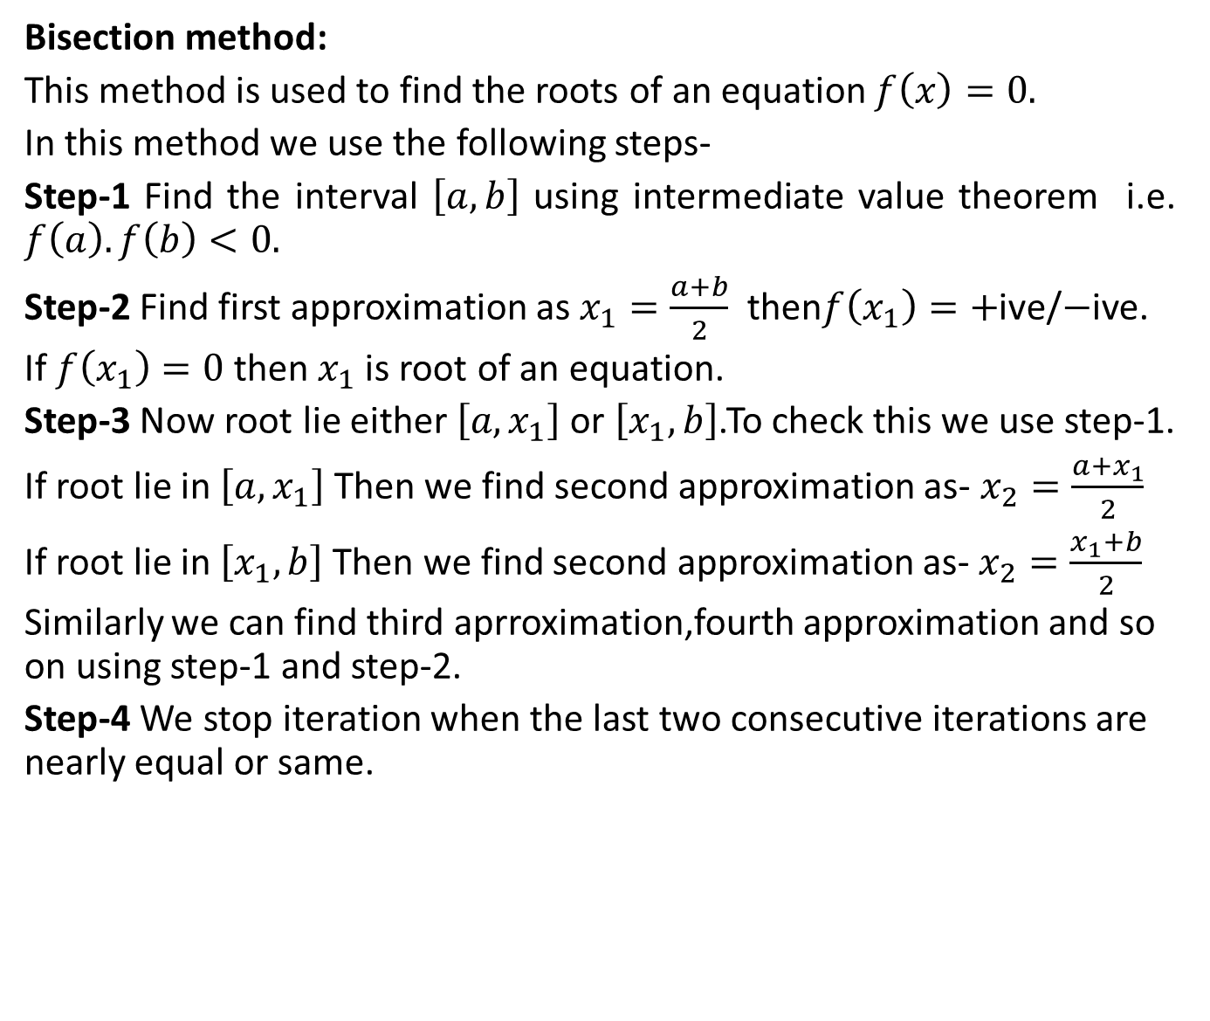
Bisection method[CO4]
Bisection method:
This method is used to find the roots of an equation $f\left(x\right)=0.$
In this method we use the following steps-
Step-1 Find the interval $\left[a,b\right]$ using intermediate value theorem i.e. $f\left(a\right).f\left(b\right)<0.$
Step-2 Find first approximation as $x_{1}=\frac{a+b}{2}$ then$f\left(x_{1}\right)=+$ive/$−$ive.
If $f\left(x_{1}\right)=0$ then${ x}_{1}$is root of an equation.
Step-3 Now root lie either $\left[a,x_{1}\right]$ or $\left[x_{1},b\right]$.To check this we use step-1.
If root lie in $\left[a,x_{1}\right]$ Then we find second approximation as- $x_{2}=\frac{a+x_{1}}{2}$
If root lie in $\left[x_{1},b\right]$Then we find second approximation as- $x_{2}=\frac{x_{1}+b}{2}$
Similarly we can find third aprroximation,fourth approximation and so on using step-1 and step-2.
Step-4 We stop iteration when the last two consecutive iterations are nearly equal or same.

Slide 12
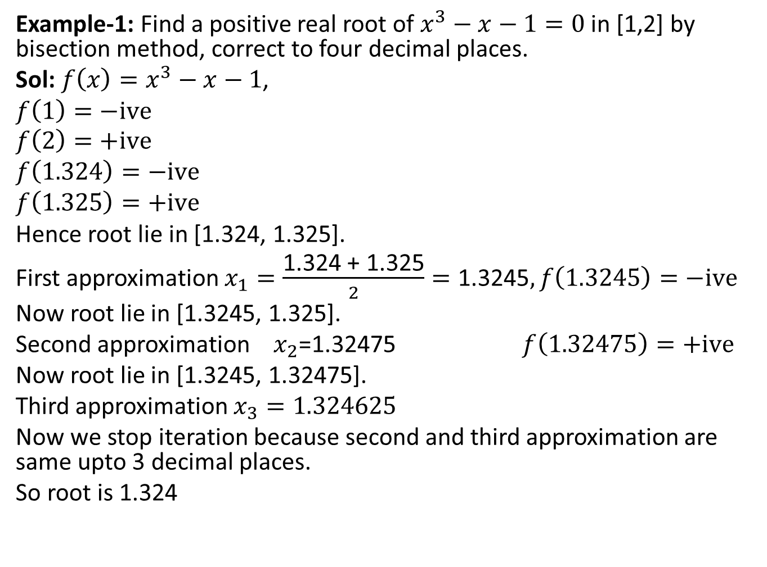
Bisection method[CO4]
Example-1: Find a positive real root of $x^{3}−x−1=0$in [1,2] by bisection method, correct to four decimal places.
Sol: $f\left(x\right)=x^{3}−x−1$,
$$f\left(1\right)=−ive$$
$$f\left(2\right)=+ive$$
$$f\left(1.324\right)=−ive$$
$$f\left(1.325\right)=+ive$$
Hence root lie in [1.324, 1.325].
First approximation $x_{1}=\frac{\text{1.324}\text{ + }\text{1.325}}{2}=\text{1.3245},f\left(1.3245\right)=−ive$
Now root lie in [1.3245, 1.325].
Second approximation $x_{2}$=1.32475 $f\left(1.32475\right)=+ive$
Now root lie in [1.3245, 1.32475].
Third approximation $x_{3}=1.324625$
Now we stop iteration because second and third approximation are same upto 3 decimal places.
So root is 1.324

Slide 13
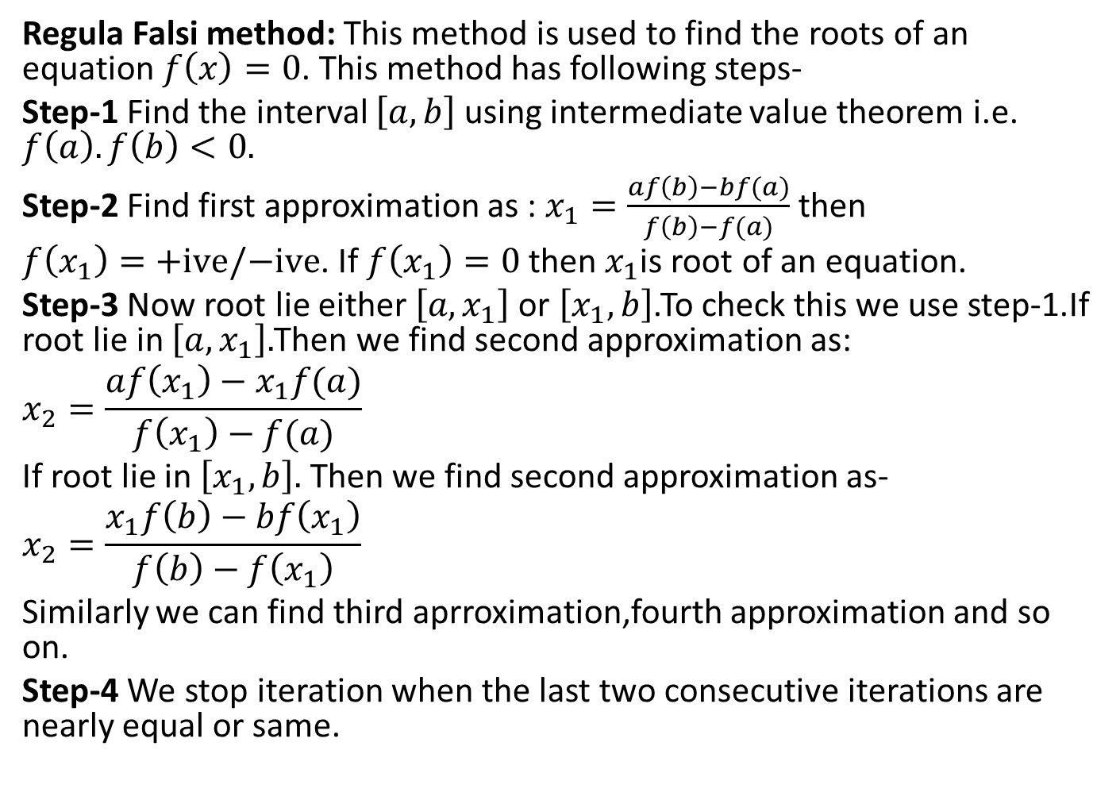
Regula Falsi method/Method of false position[CO4]
Regula Falsi method: This method is used to find the roots of an equation $f\left(x\right)=0$. This method has following steps-
Step-1 Find the interval $\left[a,b\right]$ using intermediate value theorem i.e. $f\left(a\right).f\left(b\right)<0.$
Step-2 Find first approximation as : $x_{1}=\frac{af\left(b\right)−bf(a)}{f\left(b\right)−f(a)}$then
$f\left(x_{1}\right)=+ive/−ive$. If $f\left(x_{1}\right)=0$ then${ x}_{1}$is root of an equation.
Step-3 Now root lie either $\left[a,x_{1}\right]$ or $\left[x_{1},b\right]$.To check this we use step-1.If root lie in $\left[a,x_{1}\right].$Then we find second approximation as:
$$x_{2}=\frac{af\left(x_{1}\right)−x_{1}f(a)}{f\left(x_{1}\right)−f(a)}$$
If root lie in $\left[x_{1},b\right].$ Then we find second approximation as-
$$x_{2}=\frac{x_{1}f\left(b\right)−bf\left(x_{1}\right)}{f\left(b\right)−f\left(x_{1}\right)}$$
Similarly we can find third aprroximation,fourth approximation and so on.
Step-4 We stop iteration when the last two consecutive iterations are nearly equal or same.

Slide 14
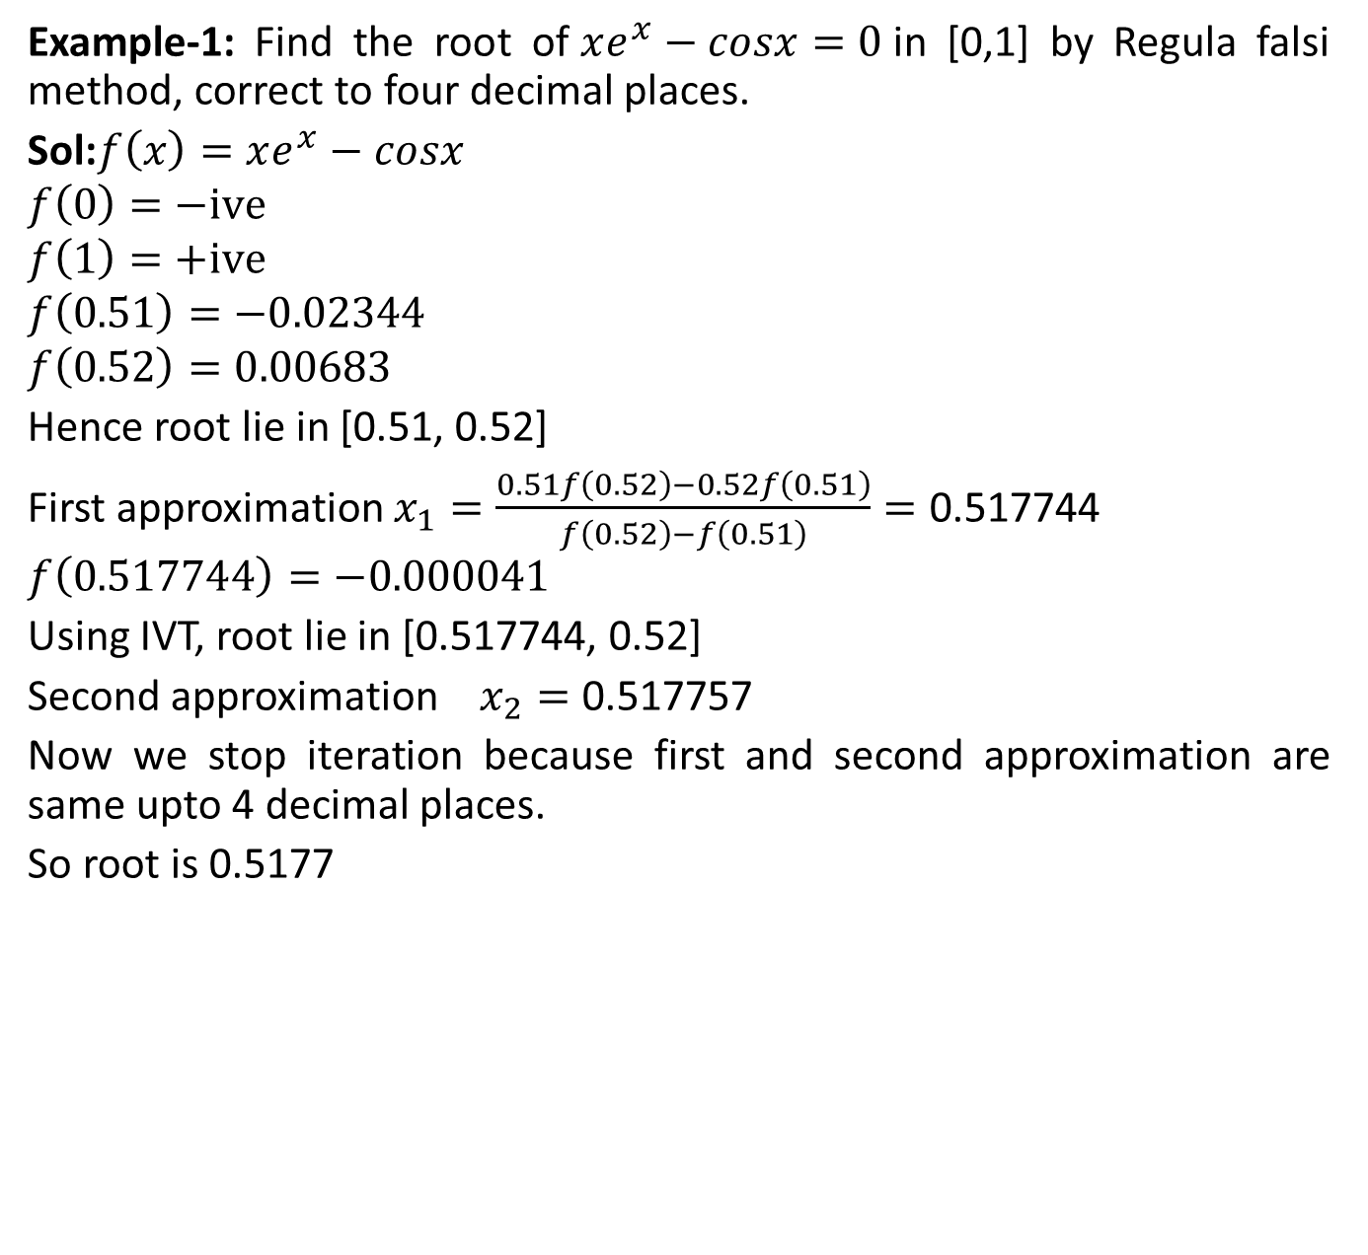
Regula Falsi method[CO4]
Example-1: Find the root of$xe^{x}−cosx=0$in [0,1] by Regula falsi method, correct to four decimal places.
Sol:$f\left(x\right)=xe^{x}−cosx$
$$f\left(0\right)=−ive$$
$$f\left(1\right)=+ive$$
$$f\left(0.51\right)=−0.02344$$
$$f\left(0.52\right)=0.00683$$
Hence root lie in [0.51, 0.52]
First approximation $x_{1}=\frac{0.51f\left(0.52\right)−0.52f\left(0.51\right)}{f\left(0.52\right)−f\left(0.51\right)}=\text{0.517744}$
$$f\left(0.517744\right)=−0.000041$$
Using IVT, root lie in [0.517744, 0.52]
Second approximation $x_{2}=\text{0.517757}$
Now we stop iteration because first and second approximation are same upto 4 decimal places.
So root is 0.5177

Slide 15


Bisection method and Regula Falsi method[CO4]
Q1: Find a positive real root of $x\log_{10}x−1.2=0$ by bisection method, correct to three decimal places.
Q2: Find a positive real root of $xe^{x}−1=0$by Regula Falsi method, correct to three decimal places.

Slide 16
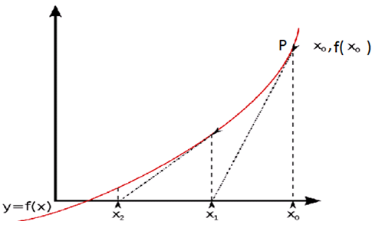
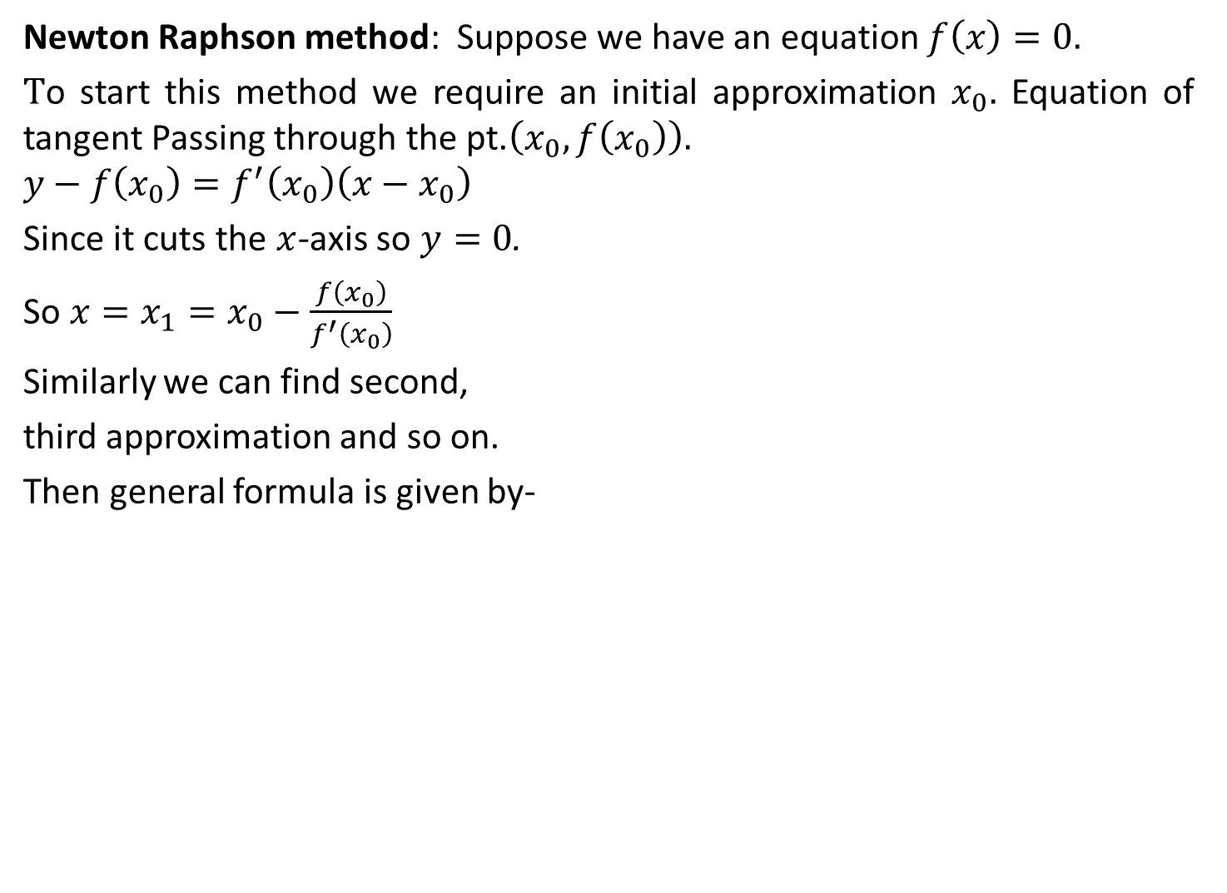
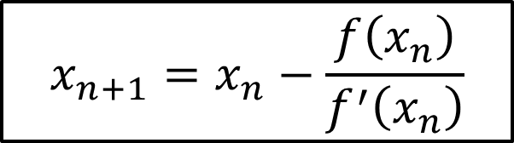
Newton Raphson method[CO4]
Newton Raphson method: Suppose we have an equation $f\left(x\right)=0.$
$T$o start this method we require an initial approximation $x_{0}.$ Equation of tangent Passing through the pt.$\left(x_{0},f\left(x_{0}\right)\right).$
$$y−f\left(x_{0}\right)=f^{′}\left(x_{0}\right)\left(x−x_{0}\right)$$
Since it cuts the $x$-axis so $y=0$.
So $x=x_{1}=x_{0}−\frac{f\left(x_{0}\right)}{f^{′}\left(x_{0}\right)}$
Similarly we can find second,
third approximation and so on.
Then general formula is given by-
$$x_{n+1}=x_{n}−\frac{f\left(x_{n}\right)}{f^{′}\left(x_{n}\right)}$$

Slide 17
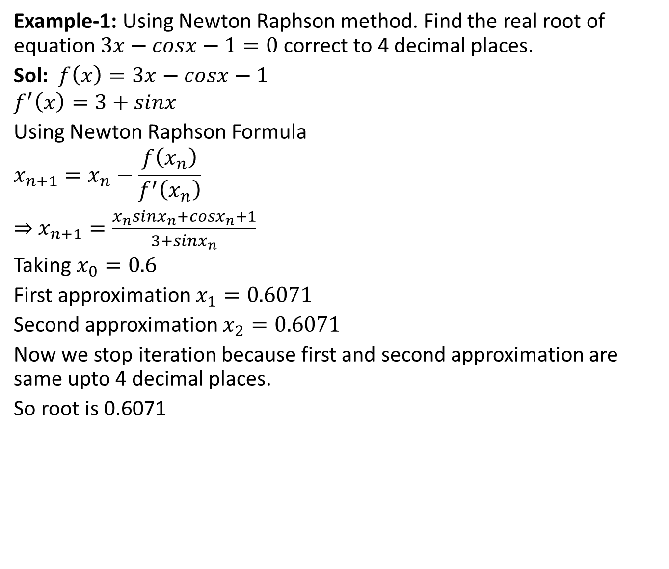
Newton Raphson method[CO4]
Example-1: Using Newton Raphson method. Find the real root of equation $3x−cosx−1=0$ correct to 4 decimal places.
Sol: $f\left(x\right)=3x−cosx−1$
$$f^{′}\left(x\right)=3+sinx$$
Using Newton Raphson Formula
$$x_{n+1}=x_{n}−\frac{f\left(x_{n}\right)}{f^{′}\left(x_{n}\right)}$$
⇒ $x_{n+1}=\frac{x_{n}sinx_{n}+cosx_{n}+1}{3+sinx_{n}}$
Taking $x_{0}=0.6$
First approximation $x_{1}=0.6071$
Second approximation $x_{2}=0.6071$
Now we stop iteration because first and second approximation are same upto 4 decimal places.
So root is 0.6071

Slide 18
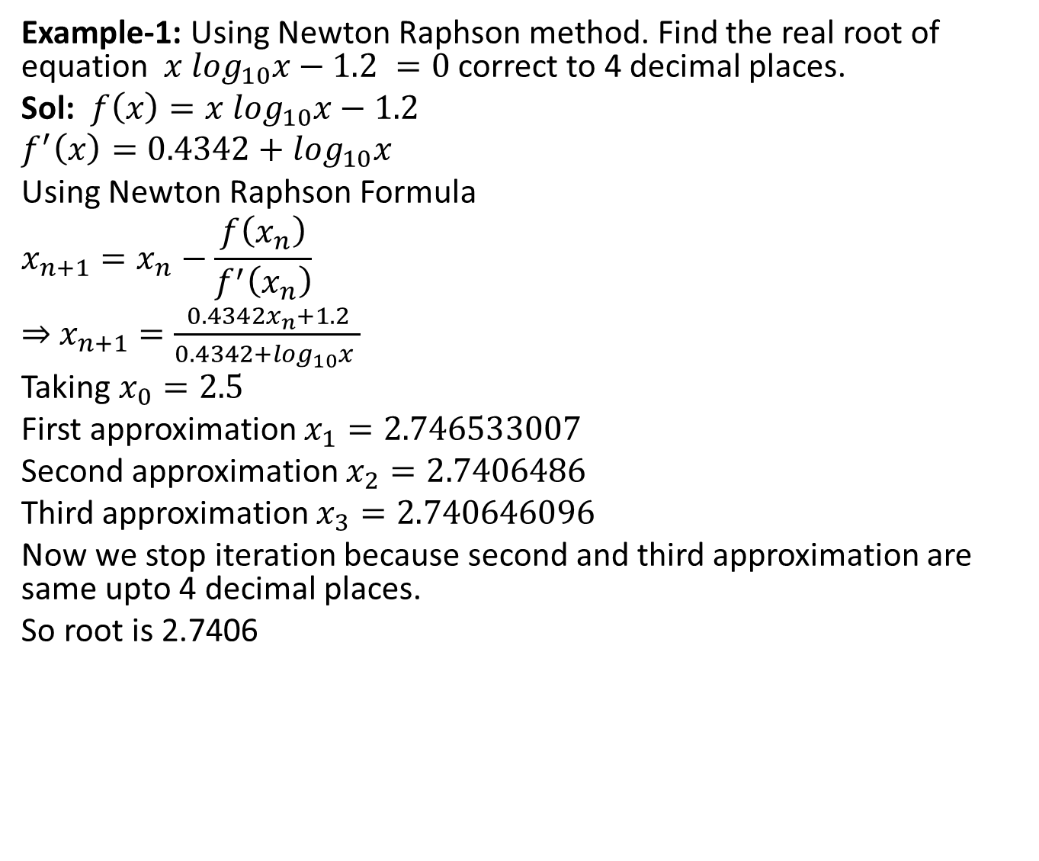
Newton Raphson method[CO4]
Example-1: Using Newton Raphson method. Find the real root of equation $x \log_{10}x−1.2 =0$ correct to 4 decimal places.
Sol: $f\left(x\right)=x \log_{10}x−1.2$
$$f^{′}\left(x\right)=0.4342+\log_{10}x$$
Using Newton Raphson Formula
$$x_{n+1}=x_{n}−\frac{f\left(x_{n}\right)}{f^{′}\left(x_{n}\right)}$$
⇒ $x_{n+1}=\frac{0.4342x_{n}+1.2}{0.4342+\log_{10}x }$
Taking $x_{0}=2.5$
First approximation $x_{1}=2.746533007$
Second approximation $x_{2}=2.7406486$
Third approximation $x_{3}=2.740646096$
Now we stop iteration because second and third approximation are same upto 4 decimal places.
So root is 2.7406

Slide 19

Newton Raphson method[CO4]
Q1 Find a positive real root of $xsinx+cosx=0$ by Newton Raphson method, correct to three decimal places.
Q2 Find a square root of 12 by Newton Raphson method, correct to 4 decimal places.

Slide 20
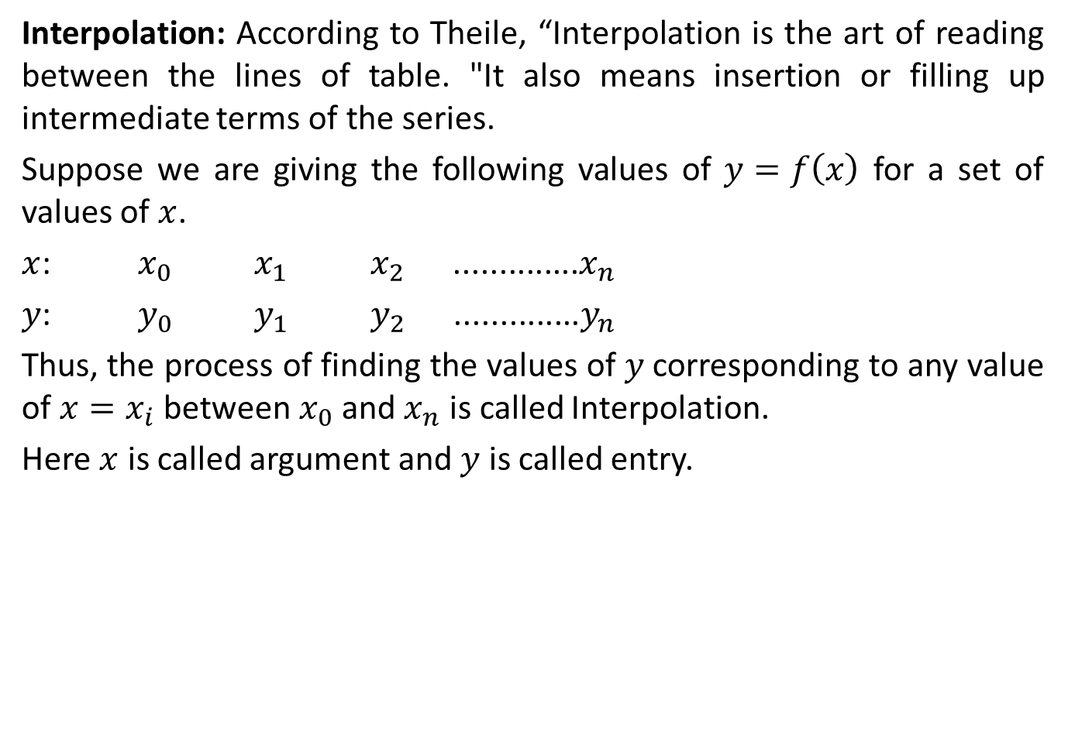
Interpolation[CO4]
Interpolation: According to Theile, “Interpolation is the art of reading between the lines of table. "It also means insertion or filling up intermediate terms of the series.
Suppose we are giving the following values of $y=f\left(x\right)$ for a set of values of $x$.
$x$: $x_{0}$ $x_{1}$ $x_{2}$..............$x_{n}$
$y$: $y_{0}$ $y_{1}$ $y_{2}$ ..............$y_{n}$
Thus, the process of finding the values of $y$corresponding to any value of $x=x_{i}$ between $x_{0}$ and $x_{n}$ is called Interpolation.
Here $x$ is called argument and $y$ is called entry.

Slide 21
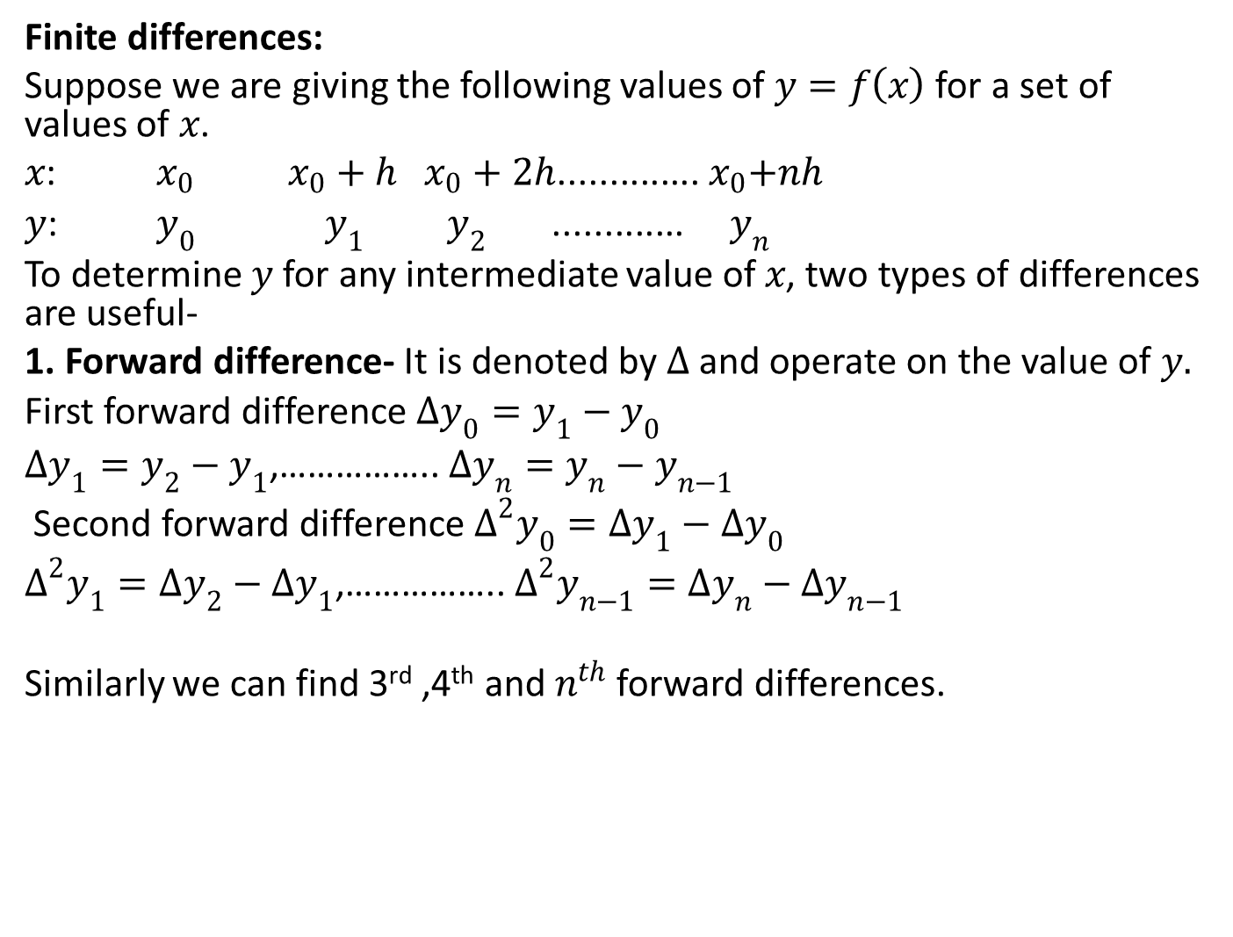
Finite differences[CO4]
Finite differences:
Suppose we are giving the following values of $y=f\left(x\right)$ for a set of values of $x$.
$x$: $x_{0}$ $x_{0}+h{ x}_{0}+2h$..............${ x}_{0}+nh$
$y$: $y_{0}$ $y_{1}$ $y_{2}$ .............$y_{n}$
To determine $y$ for any intermediate value of $x$, two types of differences are useful-
1. Forward difference- It is denoted by $∆$ and operate on the value of $y.$
First forward difference $∆y_{0}=y_{1}−y_{0}$
$∆y_{1}=y_{2}−y_{1}$,…………….. $∆y_{n}=y_{n}−y_{n−1}$
Second forward difference $∆^{2}y_{0}={∆y}_{1}−{∆y}_{0}$
$∆^{2}y_{1}={∆y}_{2}−{∆y}_{1}$,…………….. $∆^{2}y_{n−1}={∆y}_{n}−{∆y}_{n−1}$
Similarly we can find 3rd ,4th and $n^{th}$ forward differences.

Slide 22

Finite differences[CO4]
2. Backward difference- It is denoted by $∇$ and operate on the value of $y.$
First backward difference $∇y_{n}=y_{n}−y_{n−1}$
$∇y_{n−1}=y_{n−1}−y_{n−2}$,…………….. $∇y_{1}=y_{1}−y_{0}$
Second forward difference $∇^{2}y_{n}={∇y}_{n}−{∇y}_{n−1}$
$∇^{2}y_{n−1}={∇y}_{n−1}−{∇y}_{n−2}$,…………….$∇^{2}y_{2}={∇y}_{2}−{∇y}_{1}$
Similarly we can find 3rd ,4th and $n^{th}$ backward differences.

Slide 23
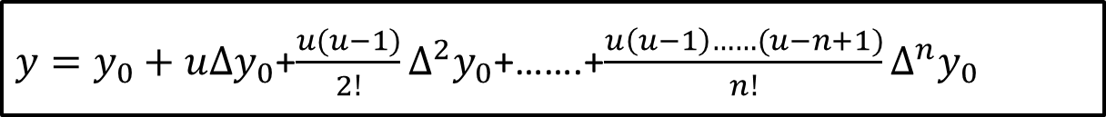
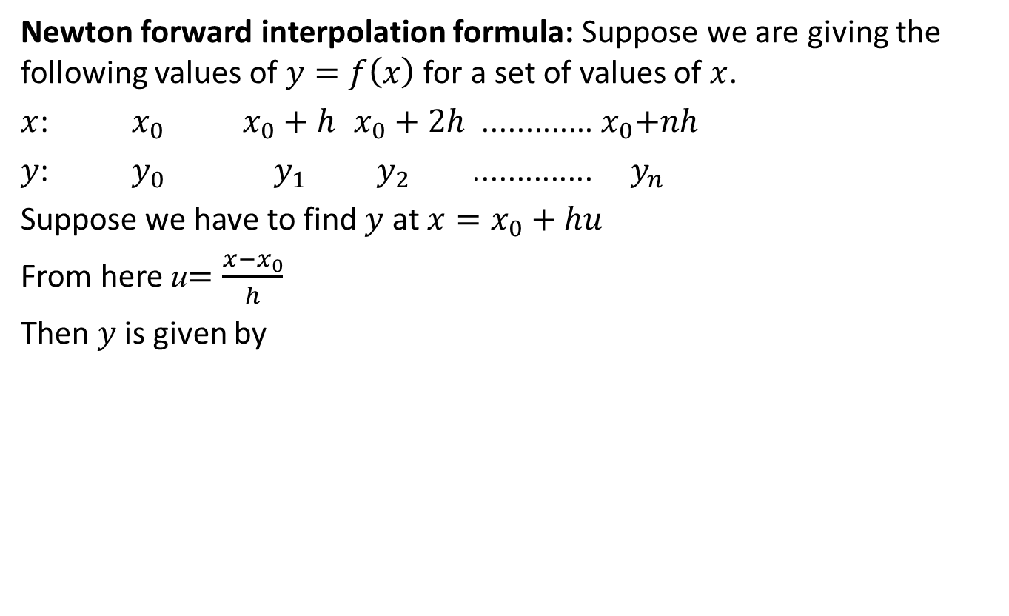
Newton forward interpolation formula[CO4]
Newton forward interpolation formula: Suppose we are giving the following values of $y=f\left(x\right)$ for a set of values of $x$.
$x$: $x_{0}$ $x_{0}+h$ $x_{0}+2h$.............${ x}_{0}+nh$
$y$: $y_{0}$ $y_{1}$ $y_{2}$ ..............$y_{n}$
Suppose we have to find $y$ at $x=x_{0}+hu$
From here u$=\frac{x−x_{0}}{h}$
Then $y$ is given by
$y=y_{0}+u∆y_{0}$+$\frac{u(u−1)}{2!}∆^{2}y_{0}$+…….+$\frac{u\left(u−1\right)……(u−n+1)}{n!}∆^{n}y_{0}$

Slide 24
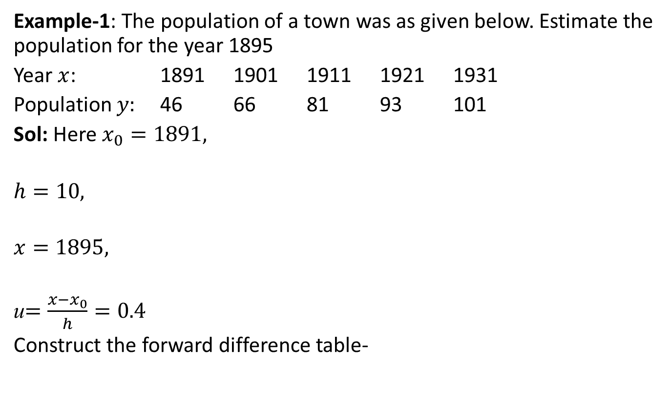
Newton forward interpolation formula[CO4]
Example-1: The population of a town was as given below. Estimate the population for the year 1895
Year $x$: 1891 1901 1911 1921 1931
Population $y:$ 46 66 81 93 101
Sol: Here $x_{0}=1891,$
$$h=10,$$
$$x=1895,$$
u$=\frac{x−x_{0}}{h}=0.4$
Construct the forward difference table-

Slide 25
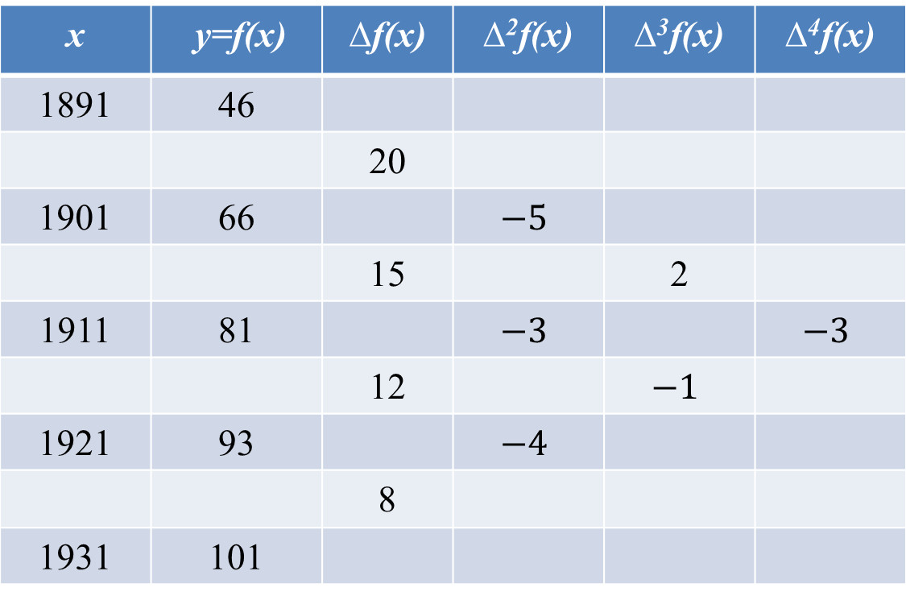
Newton forward interpolation formula[CO4]
(Forward Difference Table)
x | y=f(x) | ∆f(x) | ∆²f(x) | ∆³f(x) | ∆⁴f(x)
1891 | 46
 |  | 20
1901 | 66 |  | $$−5$$
 |  | 15 |  | 2
1911 | 81 |  | $$−3$$ |  | $$−3$$
 |  | 12 |  | $$−1$$
1921 | 93 |  | $$−4$$
 |  | 8
1931 | 101

Slide 26

Newton forward interpolation formula[CO4]
Using Newton forward interpolation formula-
${y=y}_{0}+\text{u}∆y_{0}$+$\frac{\text{u}(\text{u}−1)}{2!}∆^{2}y_{0}$+$\frac{u(u−1)(u−2)}{3!}∆^{3}y_{0}$+$\frac{u\left(u−1\right)(u−2)(u−3)}{4!}∆^{4}y_{0}$
$$y=54.85$$

Slide 27
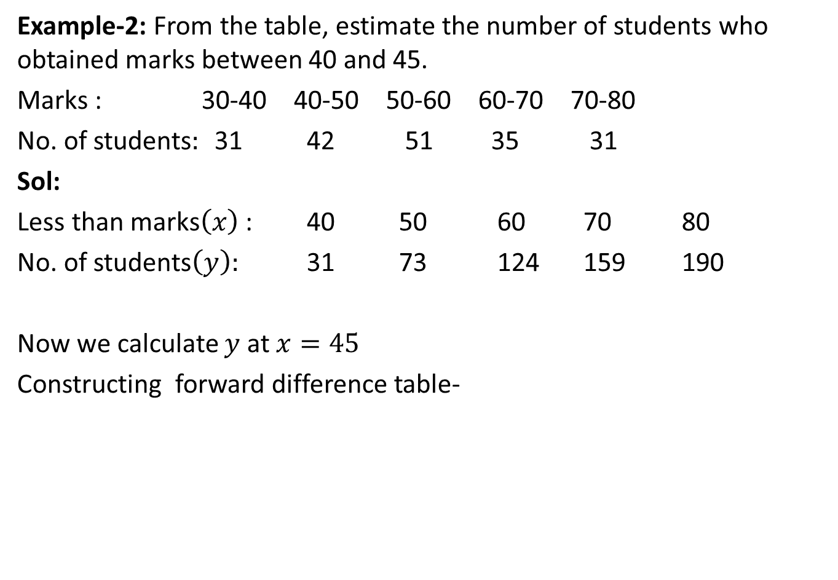
Newton forward interpolation formula[CO4]
Example-2: From the table, estimate the number of students who obtained marks between 40 and 45.
Marks : 30-40 40-50 50-60 60-70 70-80
No. of students$:$ 31 42 51 35 31
Sol:
Less than marks$\left(x\right)$ : 40 50 60 70 80
No. of students$\left(y\right):$ 31 73 124 159 190
Now we calculate $y$ at $x=45$
Constructing forward difference table-

Slide 28
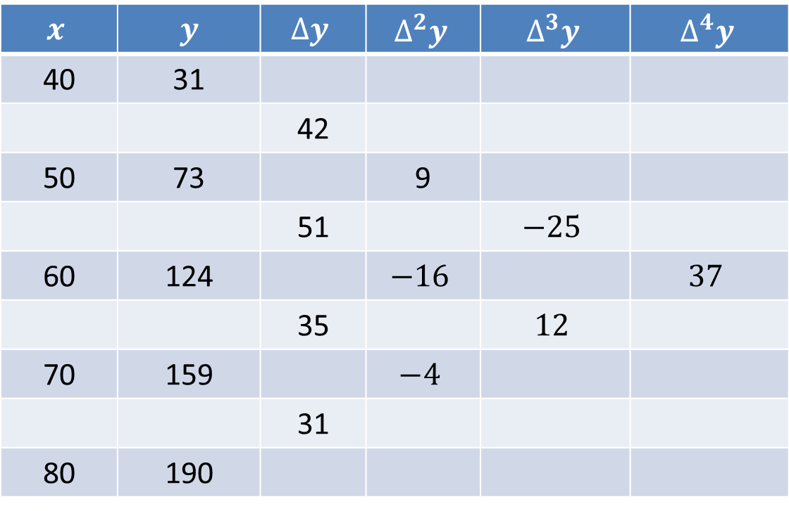
Newton forward interpolation formula[CO4]
(Forward Difference Table)
$$x$$ | $y$ | $$∆y$$ | $$∆^{2}y$$ | $$∆^{3}y$$ | $$∆^{4}y$$
40 | 31
 |  | 42
50 | 73 |  | 9
 |  | 51 |  | $$−25$$
60 | 124 |  | $$−16$$ |  | $$37$$
 |  | 35 |  | $$12$$
70 | 159 |  | $$−4$$
 |  | 31
80 | 190

Slide 29
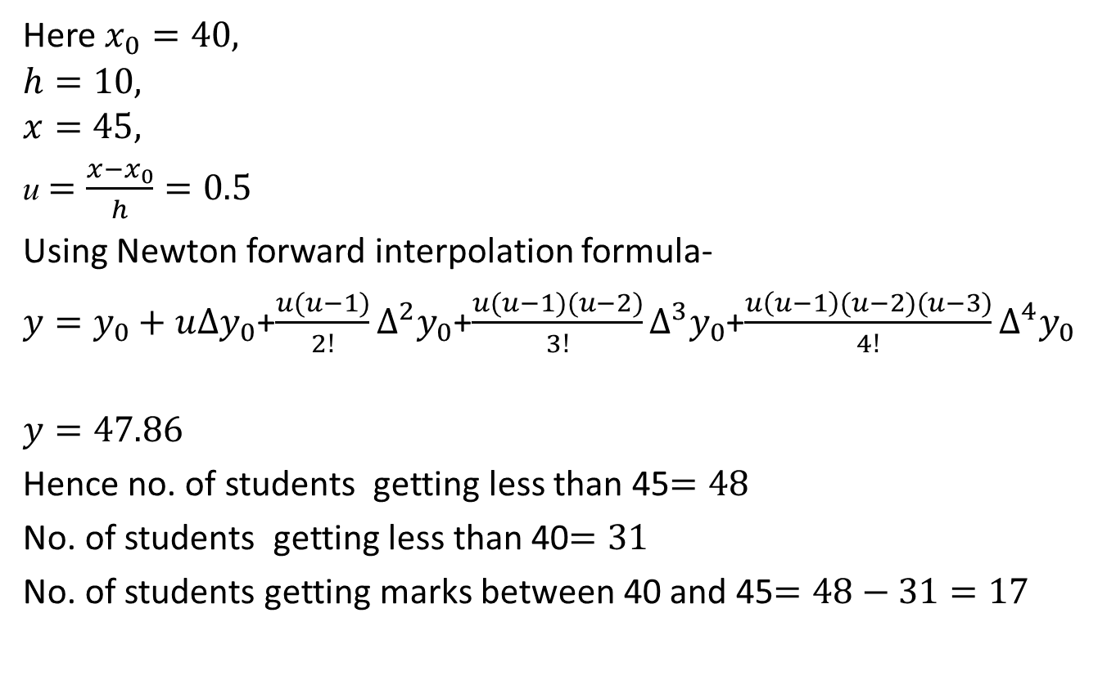
Newton forward interpolation formula[CO4]
Here $x_{0}=40,$
$$h=10,$$
$$x=45,$$
u $=\frac{x−x_{0}}{h}=0.5$
Using Newton forward interpolation formula-
${y=y}_{0}+u∆y_{0}$+$\frac{u(u−1)}{2!}∆^{2}y_{0}$+$\frac{u(u−1)(u−2)}{3!}∆^{3}y_{0}$+$\frac{u\left(u−1\right)(u−2)(u−3)}{4!}∆^{4}y_{0}$
$$y=47.86$$
Hence no. of students getting less than 45$=48$
No. of students getting less than 40$=31$
No. of students getting marks between 40 and 45$=48−31=17$

Slide 30
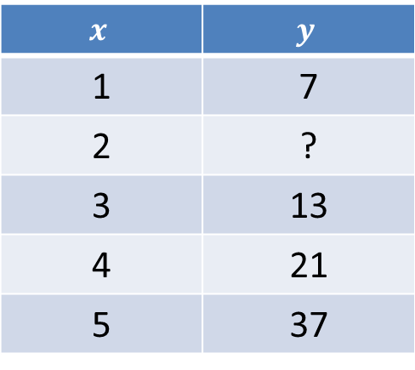
Newton forward interpolation formula[CO4]
Example-3 find the missing term in the following table-
Sol: Constructing forward difference table-
$$x$$ | $$y$$
1 | 7
2 | ?
3 | 13
4 | 21
5 | 37

Slide 31
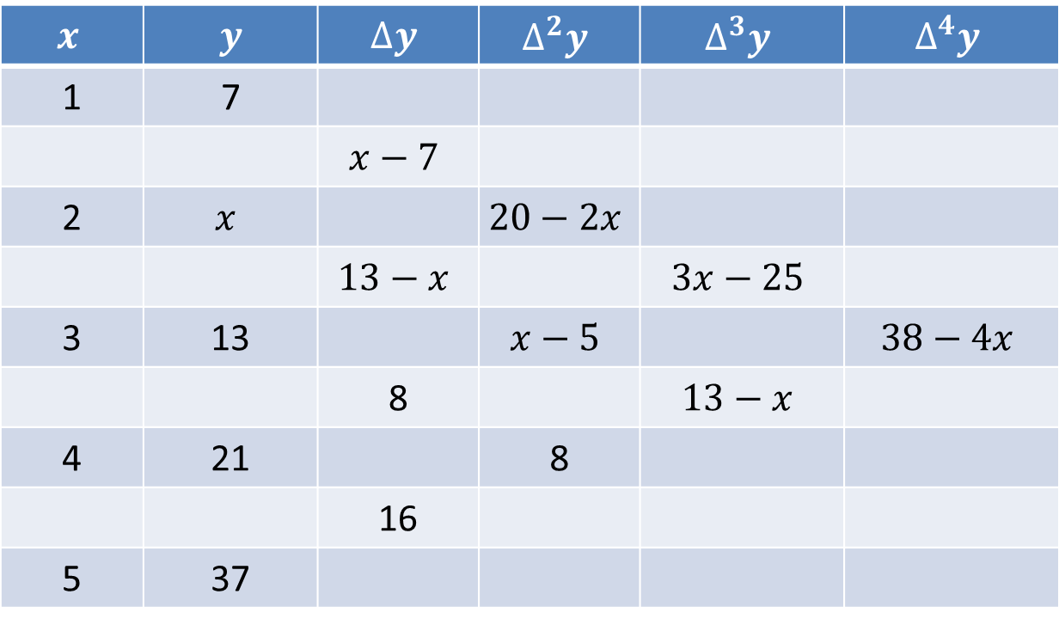
Newton forward interpolation formula[CO4]
(Forward Difference Table)
$$x$$ | $y$ | $$∆y$$ | $$∆^{2}y$$ | $$∆^{3}y$$ | $$∆^{4}y$$
1 | 7
 |  | $$x−7$$
2 | $$x$$ |  | $$20−2x$$
 |  | $$13−x$$ |  | $$3x−25$$
3 | 13 |  | $$x−5$$ |  | $$38−4x$$
 |  | 8 |  | $$13−x$$
4 | 21 |  | 8
 |  | 16
5 | 37

Slide 32

Newton forward interpolation formula[CO4]
Since we have given known value of $y$ at 4 points so degree of the polynomial is $≤3.$
So $∆^{4}y=0$
⇒ $38−4x=0$
⇒ $x=9.5$

Slide 33
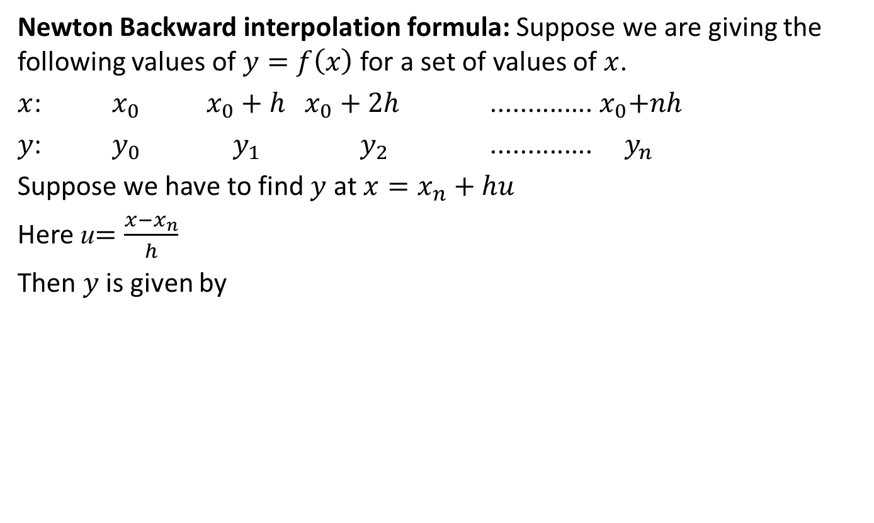
Newton Backward interpolation formula[CO4]
Newton Backward interpolation formula: Suppose we are giving the following values of $y=f\left(x\right)$ for a set of values of $x$.
$x$: $x_{0}$ $x_{0}+h{ x}_{0}+2h$ ..............${ x}_{0}+nh$
$y$: $y_{0}$ $y_{1}$ $y_{2}$ ..............$y_{n}$
Suppose we have to find $y$ at $x=x_{n}+hu$
Here u$=\frac{x−x_{n}}{h}$
Then $y$ is given by
f(x_{n}+hu)$=y_{n}+u∇y_{n}$+$\frac{u(u+1)}{2!}∇^{2}y_{n}$+…….+$\frac{u\left(u+1\right)……(u+n−1)}{n!}∇^{2}y_{n}$

Slide 34
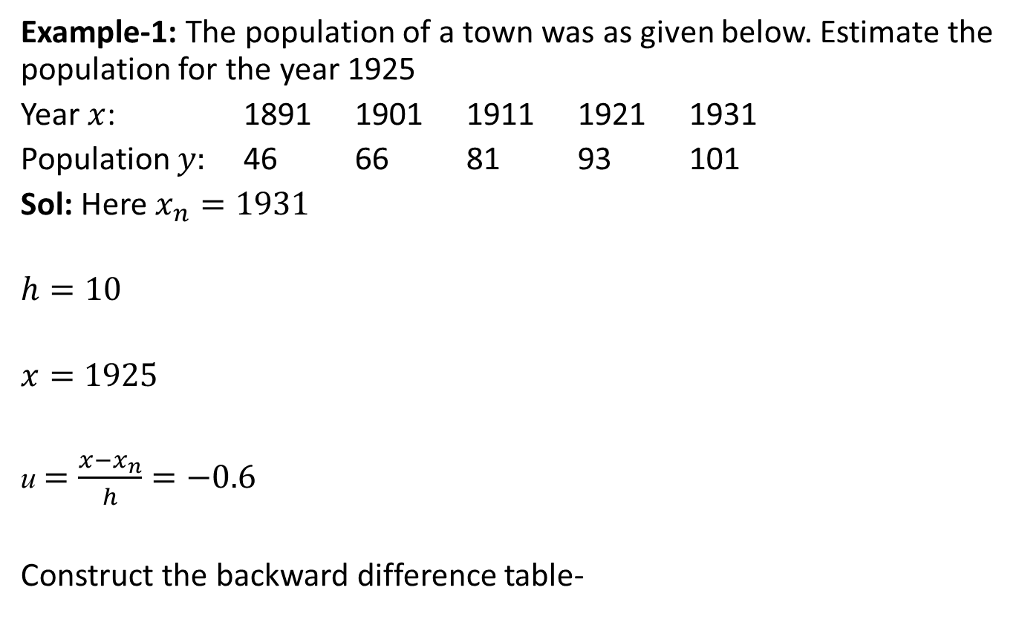
Newton Backward interpolation formula[CO4]
Example-1: The population of a town was as given below. Estimate the population for the year 1925
Year $x$: 1891 1901 1911 1921 1931
Population $y:$ 46 66 81 93 101
Sol: Here $x_{n}=1931$
$$h=10$$
$$x=1925$$
u $=\frac{x−x_{n}}{h}=−0.6$
Construct the backward difference table-

Slide 35
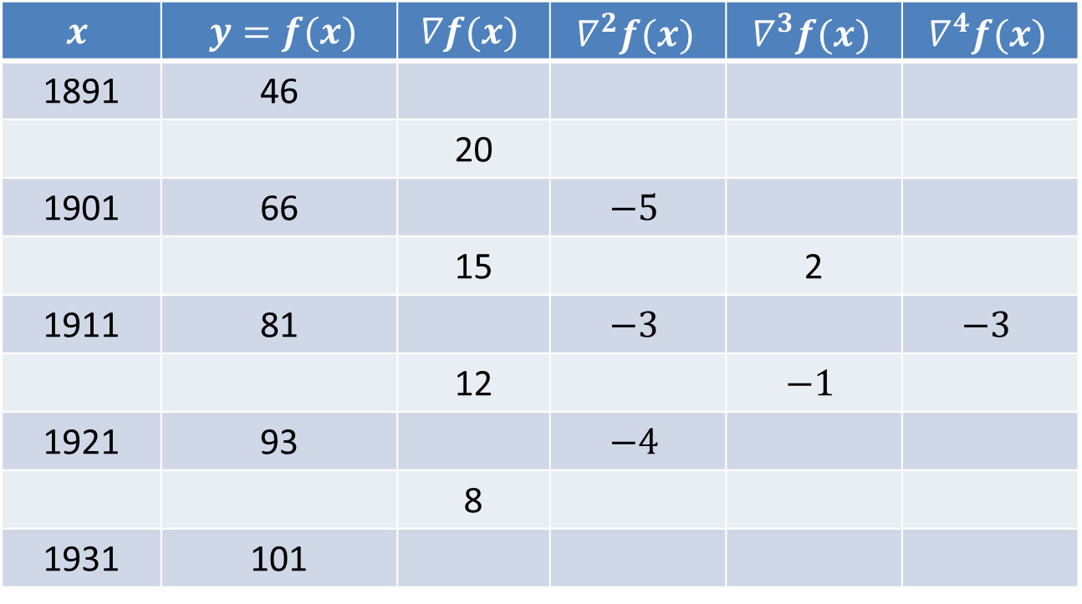
Newton Backward interpolation formula[CO4]
(Backward Difference Table)
$$x$$ | $y=f(x)$ | $$∇f(x)$$ | $$∇^{2}f(x)$$ | $$∇^{3}f(x)$$ | $$∇^{4}f(x)$$
1891 | 46
 |  | 20
1901 | 66 |  | $$−5$$
 |  | 15 |  | 2
1911 | 81 |  | $$−3$$ |  | $$−3$$
 |  | 12 |  | $$−1$$
1921 | 93 |  | $$−4$$
 |  | 8
1931 | 101

Slide 36

Newton Backward interpolation formula[CO4]
Using Newton Backward interpolation formula-
${y=y}_{n}+u∇y_{n}$+$\frac{u(u+1)}{2!}∇^{2}y_{n}$+$\frac{u(u+1)(u+2)}{3!}∇^{3}y_{n}$+$\frac{u\left(u+1\right)(u+2)(u+3)}{4!}∇^{4}y_{n}$
$$y=96.83$$

Slide 37

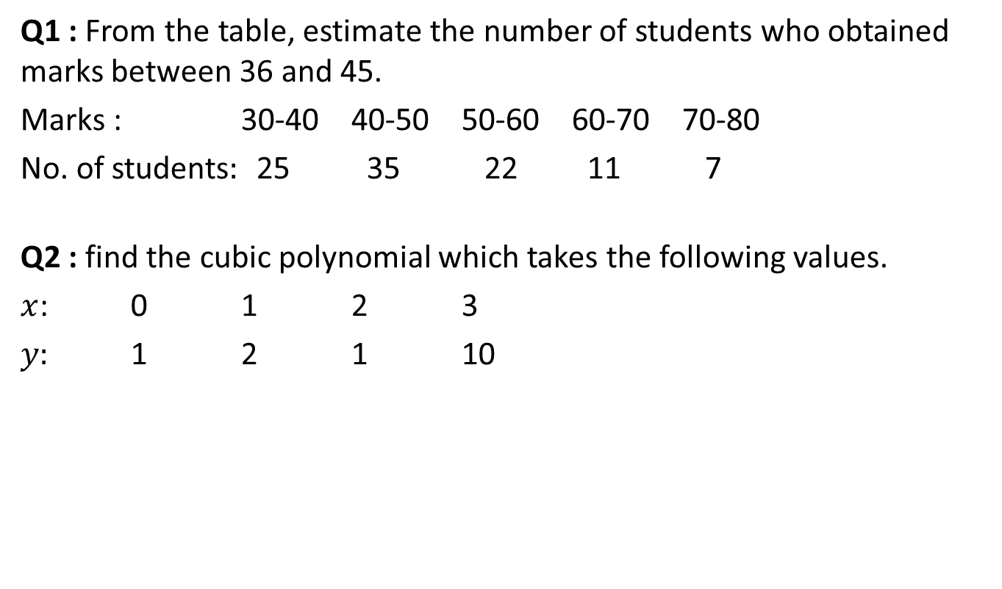
Newton Forward & Backward interpolation formula[CO4]
Q1 : From the table, estimate the number of students who obtained marks between 36 and 45.
Marks : 30-40 40-50 50-60 60-70 70-80
No. of students$:$ 25 35 22 11 7
Q2 : find the cubic polynomial which takes the following values.
$x$: 0 1 2 3
$y:$ 1 2 1 10

Slide 38
Interpolation for unequal intervals[CO4]
Lagrange’s interpolation formula
Newton divided interpolation formula

Slide 39
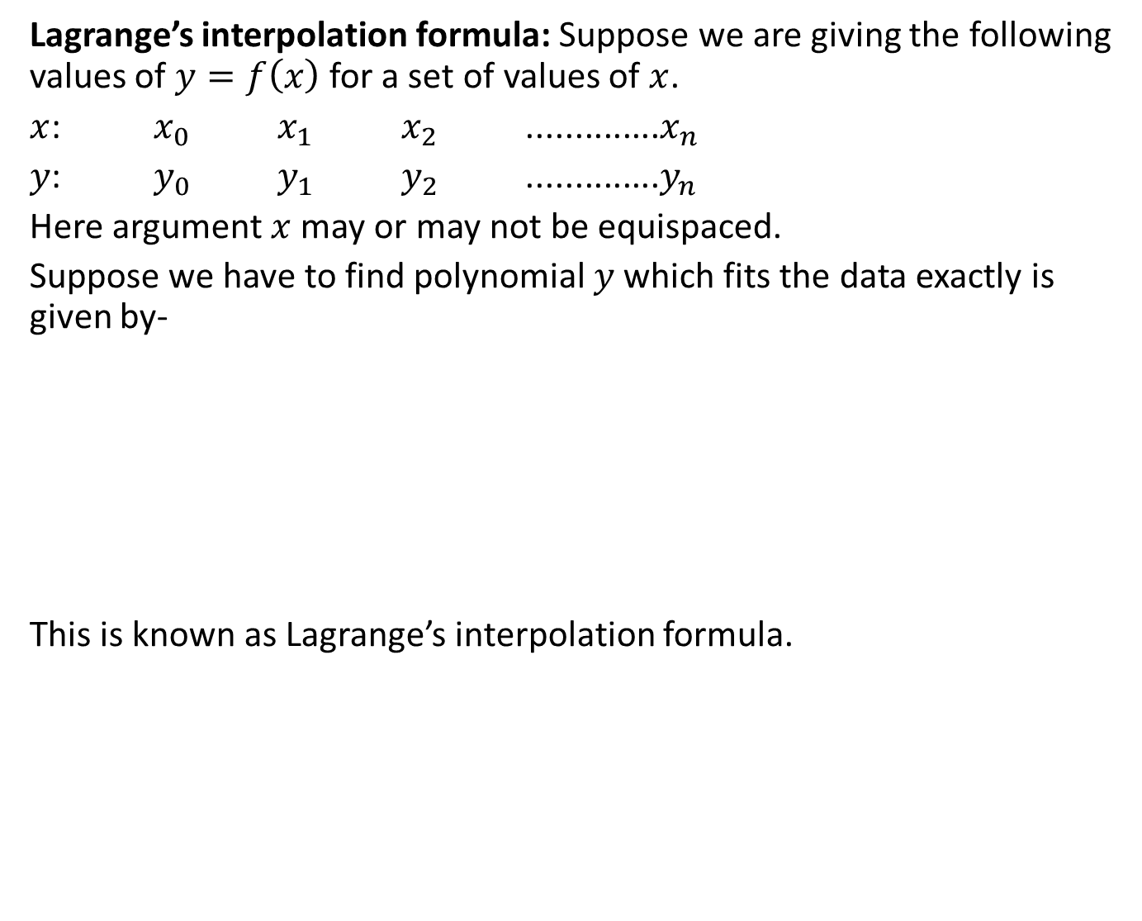
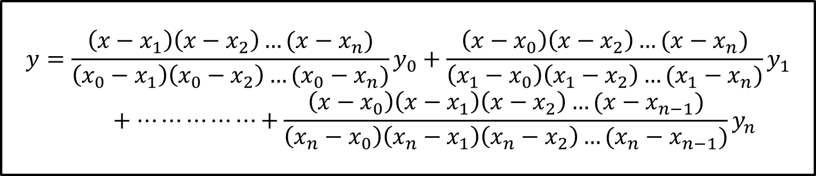
Lagrange’s interpolation formula[CO4]
Lagrange’s interpolation formula: Suppose we are giving the following values of $y=f\left(x\right)$ for a set of values of $x$.
$x$: $x_{0}$ $x_{1}$ $x_{2}$ ..............$x_{n}$
$y$: $y_{0}$ $y_{1}$ $y_{2}$ ..............$y_{n}$
Here argument $x$ may or may not be equispaced.
Suppose we have to find polynomial $y$ which fits the data exactly is given by-
This is known as Lagrange’s interpolation formula.
$$y=\frac{\left(x−x_{1}\right)\left(x−x_{2}\right)…(x−x_{n})}{\left(x_{0}−x_{1}\right)\left(x_{0}−x_{2}\right)…(x_{0}−x_{n})}y_{0}+\frac{\left(x−x_{0}\right)\left(x−x_{2}\right)…(x−x_{n})}{\left(x_{1}−x_{0}\right)\left(x_{1}−x_{2}\right)…(x_{1}−x_{n})}y_{1}+…⋯⋯⋯⋯+\frac{\left(x−x_{0}\right)\left(x−x_{1}\right)\left(x−x_{2}\right)…(x−x_{n−1})}{\left(x_{n}−x_{0}\right)\left(x_{n}−x_{1}\right)\left(x_{n}−x_{2}\right)…(x_{n}−x_{n−1})}y_{n}$$

Slide 40
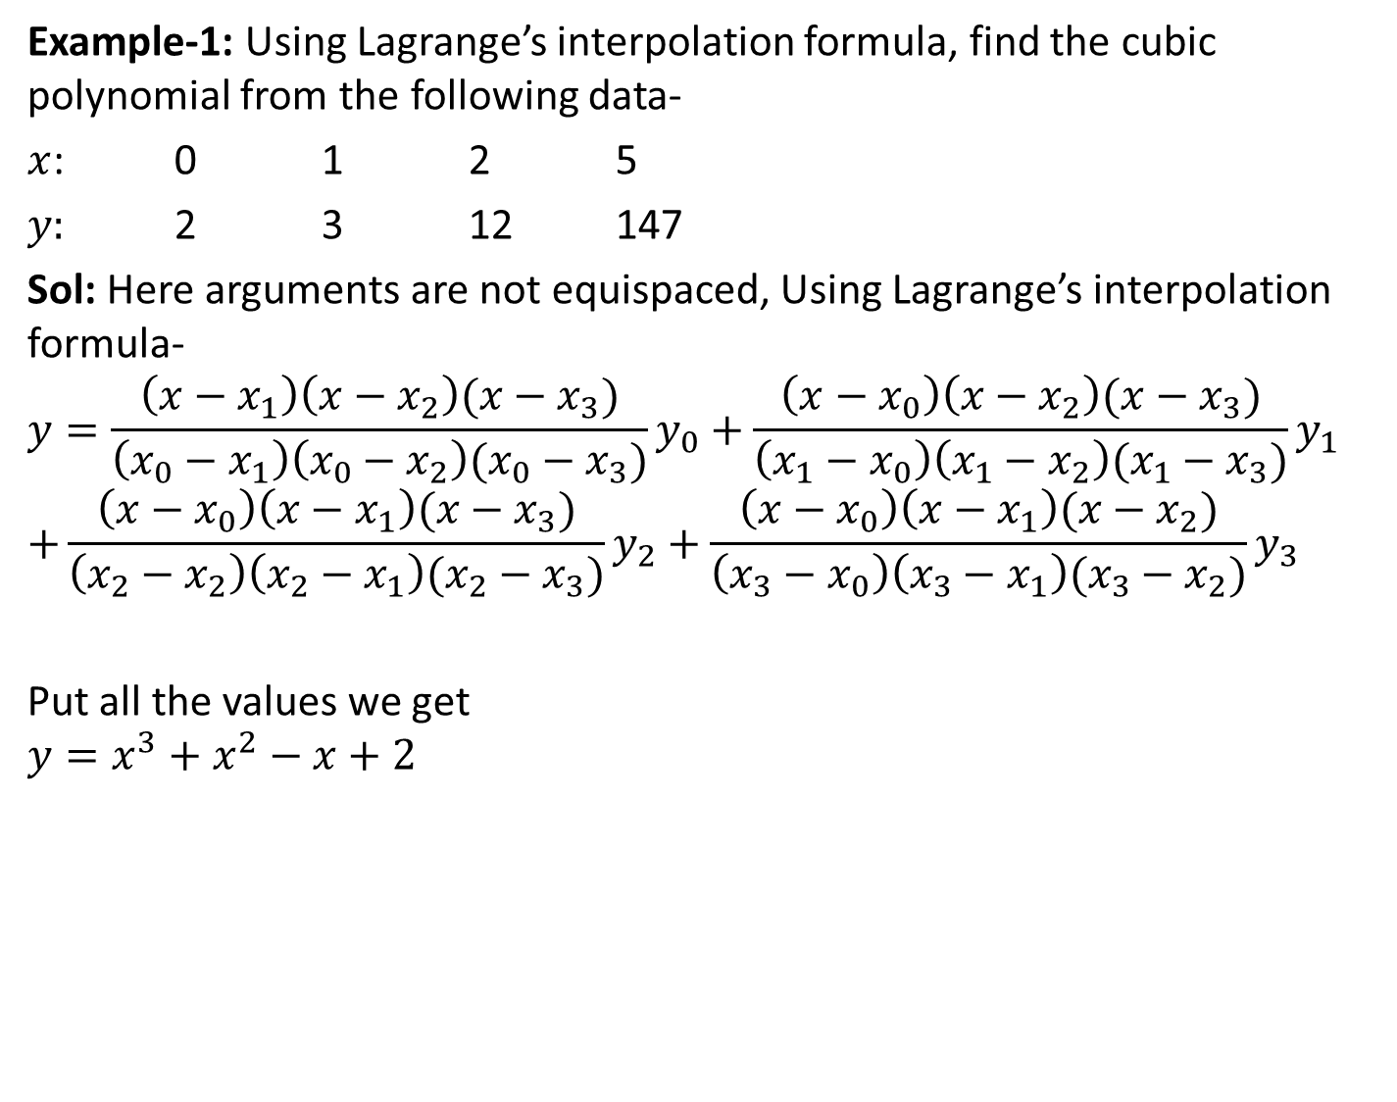
Lagrange’s interpolation formula[CO4]
Example-1: Using Lagrange’s interpolation formula, find the cubic polynomial from the following data-
$x$: 0 1 2 5
$y:$ 2 3 12 147
Sol: Here arguments are not equispaced, Using Lagrange’s interpolation formula-
$$y=\frac{\left(x−x_{1}\right)\left(x−x_{2}\right)(x−x_{3})}{\left(x_{0}−x_{1}\right)\left(x_{0}−x_{2}\right)(x_{0}−x_{3})}y_{0}+\frac{\left(x−x_{0}\right)\left(x−x_{2}\right)(x−x_{3})}{\left(x_{1}−x_{0}\right)\left(x_{1}−x_{2}\right)(x_{1}−x_{3})}y_{1}$$
$$+\frac{\left(x−x_{0}\right)\left(x−x_{1}\right)(x−x_{3})}{\left(x_{2}−x_{2}\right)\left(x_{2}−x_{1}\right)(x_{2}−x_{3})}y_{2}+\frac{\left(x−x_{0}\right)\left(x−x_{1}\right)(x−x_{2})}{\left(x_{3}−x_{0}\right)\left(x_{3}−x_{1}\right)(x_{3}−x_{2})}y_{3}$$
Put all the values we get
$$y=x^{3}+x^{2}−x+2$$

Slide 41
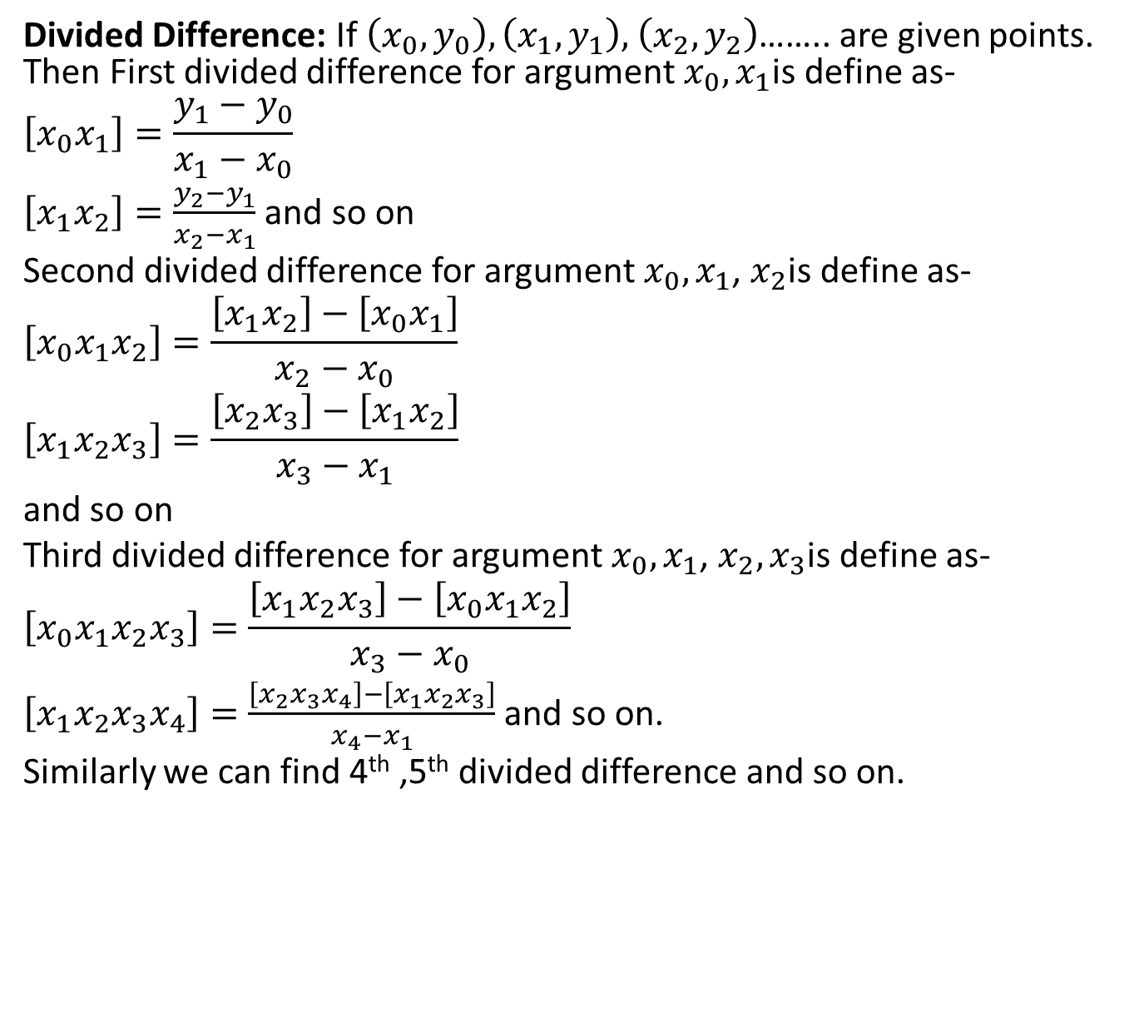
Divided Difference[CO4]
Divided Difference: If $\left(x_{0},y_{0}\right),\left(x_{1},y_{1}\right),$ $\left(x_{2},y_{2}\right)$…….. are given points. Then First divided difference for argument $x_{0}{,x}_{1}$is define as-
$$\left[x_{0}x_{1}\right]=\frac{y_{1}−y_{0}}{x_{1}−x_{0}}$$
$\left[x_{1}x_{2}\right]=\frac{y_{2}−y_{1}}{x_{2}−x_{1}}$ and so on
Second divided difference for argument $x_{0}{,x}_{1}$, $x_{2}$is define as-
$$\left[x_{0}x_{1}x_{2}\right]=\frac{\left[x_{1}x_{2}\right]−\left[x_{0}x_{1}\right]}{x_{2}−x_{0}}$$
$$\left[x_{1}x_{2}x_{3}\right]=\frac{\left[x_{2}x_{3}\right]−\left[x_{1}x_{2}\right]}{x_{3}−x_{1}}$$
and so on
Third divided difference for argument $x_{0}{,x}_{1}$, $x_{2},x_{3}$is define as-
$$\left[x_{0}x_{1}x_{2}x_{3}\right]=\frac{\left[x_{1}x_{2}x_{3}\right]−\left[x_{0}x_{1}x_{2}\right]}{x_{3}−x_{0}}$$
$\left[x_{1}x_{2}x_{3}x_{4}\right]=\frac{\left[x_{2}x_{3}x_{4}\right]−\left[x_{1}x_{2}x_{3}\right]}{x_{4}−x_{1}}$ and so on.
Similarly we can find 4th ,5th divided difference and so on.

Slide 42
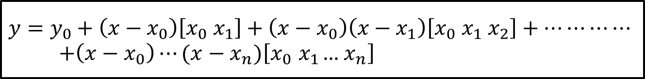
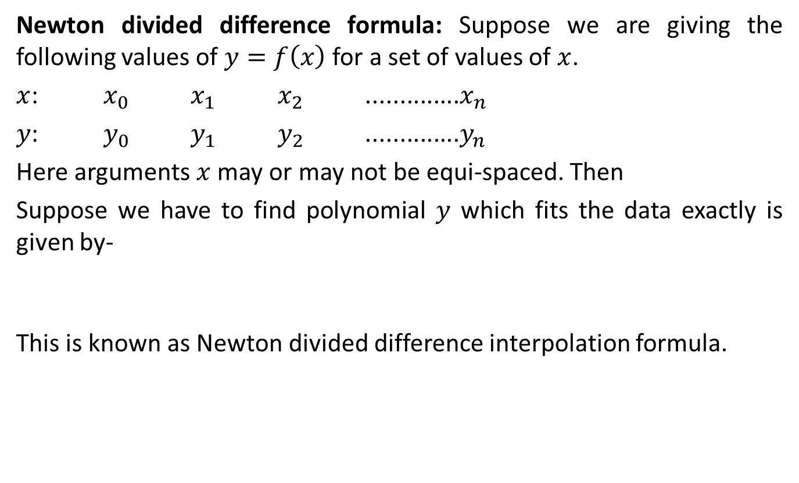
Newton divided difference formula[CO4]
Newton divided difference formula: Suppose we are giving the following values of $y=f\left(x\right)$ for a set of values of $x$.
$x$: $x_{0}$ $x_{1}$ $x_{2}$ ..............$x_{n}$
$y$: $y_{0}$ $y_{1}$ $y_{2}$ ..............$y_{n}$
Here arguments $x$ may or may not be equi-spaced. Then
Suppose we have to find polynomial $y$ which fits the data exactly is given by-
This is known as Newton divided difference interpolation formula.
$$y=y_{0}+\left(x−x_{0}\right)\left[x_{0}{ x}_{1}\right]+\left(x−x_{0}\right)\left(x−x_{1}\right)\left[x_{0}{ x}_{1} x_{2}\right]+⋯⋯⋯⋯$$
$+\left(x−x_{0}\right)⋯(x−x_{n})\left[x_{0}{ x}_{1}…{ x}_{n}\right]$

Slide 43

Newton divided difference formula[CO4]
Example-1:Using Newton Divided Difference interpolation formula, find the polynomial function from the following data-
$x$: $−4$ $−1$ 0 2 5
$y:$ 1245 33 5 9 1335
Sol:
Constructing divided difference table-

Slide 44
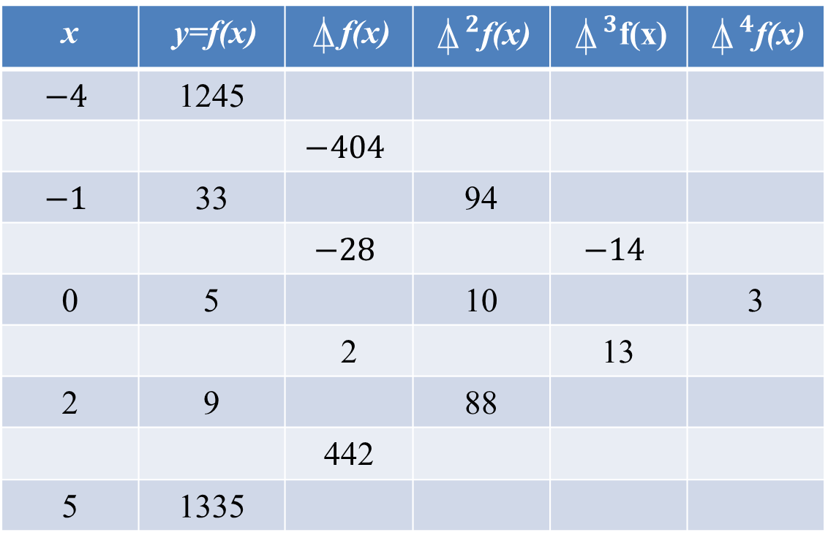
Newton divided difference formula[CO4]
(Divided Difference Table)
x | y=f(x) | $⍋$f(x) | $⍋^{2}$f(x) | $⍋^{3}$f(x) | $⍋^{4}$f(x)
$$−4$$ | 1245
 |  | $$−404$$
$$−1$$ | 33 |  | 94
 |  | $$−28$$ |  | $$−14$$
0 | 5 |  | 10 |  | 3
 |  | 2 |  | 13
2 | 9 |  | 88
 |  | 442
5 | 1335

Slide 45

Newton divided difference formula[CO4]
Applying newton divided difference formula-
$$y=y_{0}+\left(x−x_{0}\right)\left[x_{0}x_{1}\right]+\left(x−x_{0}\right)\left(x−x_{1}\right)\left[x_{0}x_{1}x_{2}\right]+\left(x−x_{0}\right)\left(x−x_{1}\right)\left(x−x_{2}\right)\left[x_{0}x_{1}x_{2}x_{3}\right]+\left(x−x_{0}\right)\left(x−x_{1}\right)\left(x−x_{2}\right)(x−x_{3})\left[x_{0}x_{1}x_{2}x_{3}x_{4}\right]$$
We get
$$y={3x}^{4}−5x^{3}+6x^{2}−14x+5$$

Slide 46
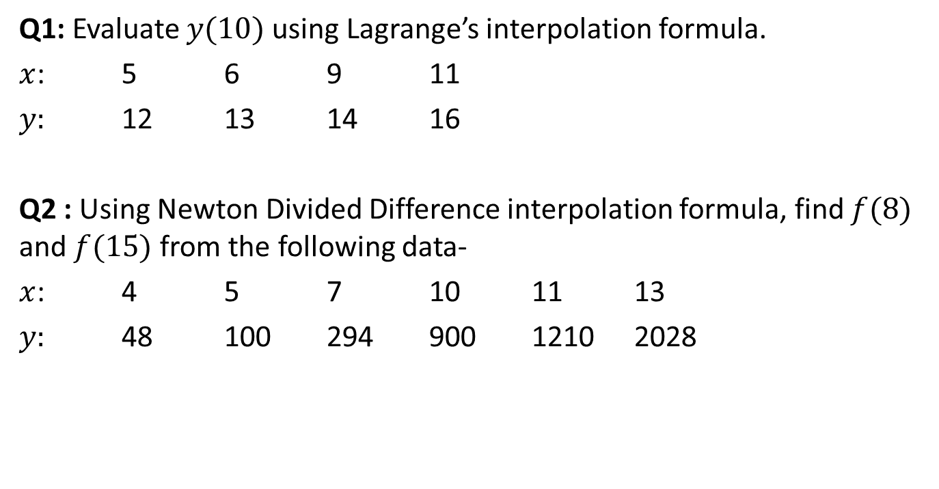
Newton divided difference formula[CO4]
Q1: Evaluate $y(10)$ using Lagrange’s interpolation formula.
$x$: 5 6 9 11
$y:$ 12 13 14 16
Q2 : Using Newton Divided Difference interpolation formula, find $f(8)$ and $f(15)$ from the following data-
$x$: 4 5 7 10 11 13
$y:$ 48 100 294 900 1210 2028

Slide 47
Summary
In previous lectures we have discussed-
Algebraic and transcendental equation
Bisection method
Regula falsi method
Newton raphson method
Order of convergence
Interpolation for equal intervals
Newton Forward interpolation formula
Newton Backward interpolation formula
Interpolation for unequal intervals
Lagrange’s interpolation formula
Newton divided difference interpolation formula

Slide 48
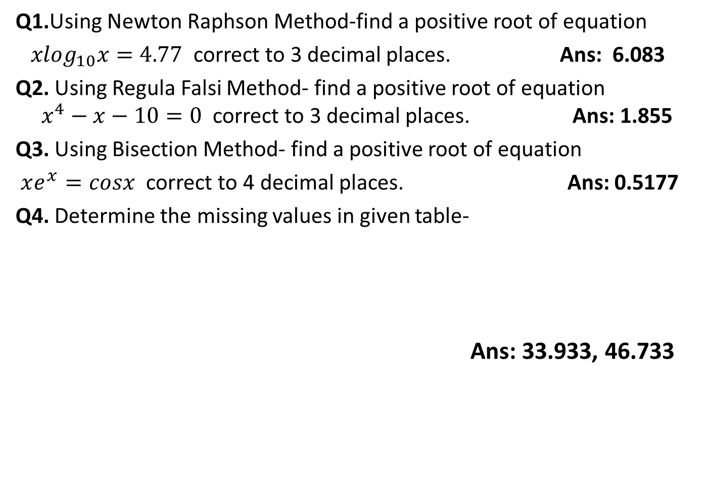
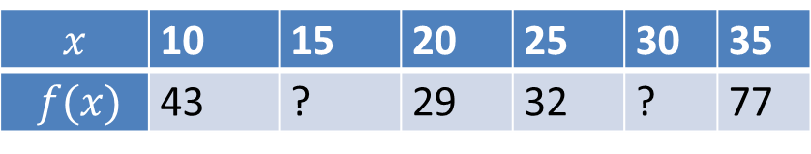
Weekly Assignment
Q1.Using Newton Raphson Method-find a positive root of equation
${xlog}_{10}x=4.77$ correct to 3 decimal places. Ans: 6.083
Q2. Using Regula Falsi Method- find a positive root of equation $x^{4}−x−10=0$ correct to 3 decimal places. Ans: 1.855
Q3. Using Bisection Method- find a positive root of equation
$xe^{x}=cosx$ correct to 4 decimal places. Ans: 0.5177
Q4. Determine the missing values in given table-
Ans: 33.933, 46.733
$$x$$ | 10 | 15 | 20 | 25 | 30 | 35
$$f(x)$$ | 43 | ? | 29 | 32 | ? | 77

Slide 49


Weekly Assignment
Q5. Find the number of students from the following data who secured marks not more than 45
Ans: 51
Q6. From the following table find the value of $y$ at $x=8$
Marks | 30-40 | 40-50 | 50-60 | 60-70 | 70-80
No. of Students | 35 | 48 | 70 | 40 | 22
$$x$$ | 1 | 3 | 5 | 7 | 9
$$y$$ | 9 | 21 | 81 | 237 | 537
Ans: 366

Slide 50



Weekly Assignment
Q7. Obtain Lagrange’s interpolatory polynomial for the following data-
Also find the value of $y$ at $x=1.5.$
Ans: $x^{3}−9x^{2}+17x+6$, 14.625
Q8. Find the interpolating polynomial and hence compute $f(1)$ from the following table-
Ans: ${5x}^{4}+9x^{3}−27x^{2}−21x−12, −46$
$$x$$ | -1 | 1 | 2 | 3
$$y$$ | -21 | 15 | 12 | 3
$$x$$ | $$−3$$ | $$−1$$ | 0 | 3 | 5
$$f(x)$$ | $$−30$$ | $$−22$$ | $$−12$$ | 330 | 3458

Slide 51
Objective of solving system of equations by numerical method[CO4]
Applying numerical methods we can solve large system of linear equations.

Slide 52

Solution of system of linear equations[CO4]
Consider a non-homogeneous system of three simultaneous linear algebraic equations in three unknowns as
$$a_{11}x_{1}+ a_{12}x_{2} + a_{13}x_{3} = b_{1}$$
$$a_{21}x_{1}+ a_{22}x_{2} + a_{23}x_{3} = b_{2} ……………..(1)$$
$a_{31}x_{1}+ a_{32}x_{2} + a_{33}x_{3} = b_{3}$
where all $a_{ij}$'s and $b_{j}$'s are constants.
Using matrix notation, the above system (1) can be written as
$AX=B$ .................(2)
$\left[\begin{matrix}a_{11} & a_{12} & a_{13} \\ a_{21} & a_{22} & a_{23} \\ a_{31} & a_{32} & a_{33}\end{matrix}\right]$ $\left[\begin{matrix}x_{1} \\ x_{2} \\ x_{3}\end{matrix}\right]$=$\left[\begin{matrix}b_{1} \\ b_{2} \\ b_{3}\end{matrix}\right]$
By finding a solution of the system, we mean to obtain the values of three unknowns$x_{1}$, $x_{2}$ and $x_{3}$ such that they satisfy the given equations

Slide 53
Matrix Decomposition Method [CO4]
This method is also known as Triangularization method or method of factorization.
The given system of equations can be written in matrix form as AX=B.......(1)
Factor A into LU, where L is lower triangular matrix and U is upper triangular matrix.
Put A=LU in (1), we have LUX=B......(2)
Let UX=Y....(3) then (2) becomes LY=B.....(4)
Solve (4) for Y using forward substitution

Slide 54
Matrix Decomposition Method[CO4]
Putting the value of Y in (3) and solve it for X using back substitution method.
Some important points:
If we take all the diagonal elements of L=1 then the method is called Doolittle’s method.
If we take all the diagonal elements of U=1 then the method is called Crout’s method.
The method fails if any of the diagonal elements of L or U is zero.

Slide 55

Crout’s method [CO4]
Example: Solve, by Crout’s method, the following system of equations: $$x+y+z=3, 2x−y+3z=16, 3x+y−z=−3$$
Solution:
The above system of equations can be written in matrix form as AX=B...........(1)
Where $A=\left[\begin{matrix}1 & 1 & 1 \\ 2 & −1 & 3 \\ 3 & 1 & −1\end{matrix}\right]$ $X=\left[\begin{matrix}x \\ y \\ z\end{matrix}\right]$ and $B=\left[\begin{matrix}3 \\ 16 \\ −3\end{matrix}\right]$
In Crout’s method $A=LU$.............(2)
$\left[\begin{matrix}1 & 1 & 1 \\ 2 & −1 & 3 \\ 3 & 1 & −1\end{matrix}\right]$=$\left[\begin{matrix}l_{11} & 0 & 0 \\ l_{21} & l_{22} & 0 \\ l_{31} & l_{32} & l_{33}\end{matrix}\right]$ $\left[\begin{matrix}1 & u_{12} & u_{13} \\ 0 & 1 & u_{23} \\ 0 & 0 & 1\end{matrix}\right]$

Slide 56

Crout’s method [CO4]
On simplifying, we get
L=$\left[\begin{matrix}1 & 0 & 0 \\ 2 & −3 & 0 \\ 3 & −2 & \frac{−14}{3}\end{matrix}\right]$ U=$\left[\begin{matrix}1 & 1 & 1 \\ 0 & 1 & \frac{−1}{3} \\ 0 & 0 & 1\end{matrix}\right]$
Put A=LU in (1), we have LUX=B..........................(3)
Let UX=Y......(4) so that (3) becomes LY=B............(5)
So by (5), we have$\left[\begin{matrix}1 & 0 & 0 \\ 2 & −3 & 0 \\ 3 & −2 & \frac{−14}{3}\end{matrix}\right]$ $\left[\begin{matrix}y_{1} \\ y_{2} \\ y_{3}\end{matrix}\right]$= $\left[\begin{matrix}3 \\ 16 \\ −3\end{matrix}\right]$.........(6)

Slide 57

Crout’s method [CO4]
After solving (6), using forward substitution method, we have
Y$=\left[\begin{matrix}y_{1} \\ y_{2} \\ y_{3}\end{matrix}\right]=\left[\begin{matrix}3 \\ \frac{−10}{3} \\ 4\end{matrix}\right]$
Now, UX=Y
So $\left[\begin{matrix}1 & 1 & 1 \\ 0 & 1 & −\frac{1}{3} \\ 0 & 0 & 1\end{matrix}\right]$ $\left[\begin{matrix}x \\ y \\ z\end{matrix}\right]$=$\left[\begin{matrix}3 \\ −\frac{10}{3} \\ 4\end{matrix}\right]$.........(7)
After solving (7), using backward substitution method,
we have $x=1, y=−2$ and $z=4.$

Slide 58

Crout’s method [CO4]
Q.1 Solve by Crout’s Method
$$10x+y+z=12 \\ 2x+10y+z=13$$
$2x+2y+10z=14$

Slide 59

Diagonally Dominant Matrix [CO4]
In mathematics, a matrix is said to be diagonally dominant if for every row of the matrix, the magnitude of the diagonal entry in a row is larger than or equal to the sum of the magnitudes of all the other (non-diagonal) entries in that row.
Ex: The matrix A= $\left[\begin{matrix}4 & 1 & 1 \\ 2 & −6 & 3 \\ 3 & 1 & −4\end{matrix}\right]$is diagonally dominant matrix because │4│>│1│+ │1│
│-6│>│2│+ │3│
│-4│=│3│+ │1│.

Slide 60

Gauss-Seidel Method [CO4]
The Gauss-Seidel method is a method for determining the solution of a diagonally dominant system of linear equations.
Consider a non-homogeneous system of three simultaneous linear algebraic equations in three unknowns as-
$$a_{11}x_{1}+ a_{12}x_{2} + a_{13}x_{3} = b_{1}$$
$$a_{21}x_{1}+ a_{22}x_{2} + a_{23}x_{3} = b_{2} ……………..(1)$$
$a_{31}x_{1}+ a_{32}x_{2} + a_{33}x_{3} = b_{3}$
where $a_{ii}$'s is the largest coefficient in the $i^{th}$ equation $(i=1,2,3)$
System (1) of equations can be written as
$$x= \frac{b_{1}}{a_{11}} − \frac{a_{12}y}{a_{11}} − \frac{a_{13}z}{a_{11}} …………………………..\left(2\right)$$
$$y= \frac{b_{2}}{a_{22}} − \frac{a_{21}x}{a_{22}} − \frac{a_{23}z}{a_{22}} …………………………..\left(3\right)$$
$$z= \frac{b_{3}}{a_{33}} − \frac{a_{31}x}{a_{33}} − \frac{a_{32}y}{a_{33}} …………………………..(4)$$

Slide 61

Gauss-Seidel Method [CO4]
Taking the initial approximation $y^{(0)}=z^{(0)}=0$.
Put the initial approximation in R.H.S. of (2) to get the next approximation for $x$i.e.
$\frac{b_{1}}{a_{11}}$
Now put $x^{(1)}=$ $\frac{b_{1}}{a_{11}}$, $z^{(0)}=0$ in (3)
we have $y^{(1)}=$ $\frac{b_{2}}{a_{22}}−\frac{a_{21}}{a_{22}}\frac{b_{1}}{a_{11}}$
Now put $x^{(1)}=$ $\frac{b_{1}}{a_{11}}$, $y^{(1)}=$ $\frac{b_{2}}{a_{22}}$ - $\frac{a_{21}}{a_{22}}\frac{b_{1}}{a_{11}}$ in(4)
we have $z^{(0)}=\frac{b_{3}}{a_{33}}−$ $\frac{a_{31}}{a_{33}}$ $\frac{b_{1}}{a_{11}}−$ $\frac{a_{32}}{a_{33}}$ ($\frac{b_{2}}{a_{22}}−$ $\frac{a_{21}}{a_{22}}\frac{b_{1}}{a_{11}}$ )
Repeat this process until we get the desired valued of unknowns (variables $x,y,z$) upto required accuracy.

Slide 62

Gauss-Seidel Method [CO4]
Example: Solve the following system of equations by Gauss-Seidel method
$$2x+10y+z=51$$
$$10x+y+2z=44$$
$$x+2y+10z=61$$
Solution: The given system is not diagonally dominant. So, rearrange the equations as follows to make them diagonally dominant:
$$10x+y+2z=44$$
$$2x+10y+z=51 …………………..\left(1\right)$$
$$x+2y+10z=61$$
$System (1) of$equations can be written as
$x=\frac{1}{10}\left(44−y−2z\right)$ ..............(2)
$y=\frac{1}{10}\left(51−2x−z\right)$ ...............(3)
$z=\frac{1}{10}\left(61−x−2y\right)$ .........(4)

Slide 63


Gauss-Seidel Method [CO4]
The first approximation is obtained by putting $y=z=0$ in (2)
$x^{(1)}=4.4$ Now, putting $x=4.4$and $z=0$ in (3), we get $y^{(1)}=4.2$
Again putting $x=4.4, y=4.2$in (4), we get $z^{(1)}=−2.9753$
Proceeding in the same way , we get

Slide 64

Gauss-Seidel Method [CO4]
Proceeding in the same way, we get
Hence, after four iterations, we get
$$x=3, y=4 ,z=5$$

Slide 65

Gauss-Seidel Method [CO4]
Q.1 Solve the following system of equations by Gauss-Seidel method(Perform four iteration)
$$9x+4y+z=−17$$
$$x−2y−6z=14$$
$$x+6y=4$$
Q.2 Solve the following system of equations by Gauss-Seidel method.
$$20x+y−2z=17$$
$$3x+20y−z=−18$$
$$2x−3y+20z=25$$

Slide 66
Objective of Numerical Integration [CO4]
Using numerical techniques, we can solve definite integral.

Slide 67


Numerical Integration [CO4]
The process of evaluating a definite integral from a set of tabulated values of the integrand $f(x)$ is called numerical integration.
Numerical integration means the numeric evaluation of integral
$I=\int_{a}^{b}{f\left(x\right)dx}$ .......(1)
where $a$and $b$ are given and $f$ is a function given analytically by a formula or empirically by a table of values.
Geometrically, (1) gives the area under the curve of f between $a$ and $b$.

Slide 68

Trapezoidal Rule [CO4]
Let $y_{0},y_{1},y_{2},…….y_{n}$ be the values of $y=f(x)$ corresponding to
$x=x_{0}=a,x_{1},x_{2},…….x_{n}=b$, which are equally spaced with interval as $h$. Then the Trapezoidal rule is given by
$I=\int_{a}^{b}{f\left(x\right)dx=}\frac{h}{2}[y_{0}+2\left(y_{1}+y_{2}+……{+y}_{n−1}\right)+y_{n}]$ …...(1)
Where $h=\frac{(b−a)}{n}$, $n=$number of subintervals

Slide 69


Trapezoidal Rule [CO4]
Example: Evaluate $I=\int_{0}^{1}{\frac{1}{1+x}dx}$ by Trapezoidal rule (Take $n=6$).
Solution:
Here $h=\frac{b−a}{n}=\frac{1−0}{6}=\frac{1}{6}$
Now, by (1)
$$\int_{0}^{1}{\frac{1}{1+x}dx=\frac{1}{6×2}}\left[1+2\left(0.8571+0.75+0.6666+0.6+0.5454\right)+0.5\right]$$
$=0.69485$
$$x$$ | $$0$$ | $$1/6$$ | $$2/6$$ | $$3/6$$ | $$4/6$$ | $$5/6$$ | $$1$$
$$f(x)=\frac{1}{1+x}$$ | $$1$$ | $$0.8571$$ | $$0.75$$ | $$0.6666$$ | $$0.6$$ | $$0.5454$$ | $$0.5$$

Slide 70


Simpson’s $\frac{1}{3}$ Rule [CO4]
Let $y_{0},y_{1},y_{2},…….y_{n}$ be the values of $y=f(x)$ corresponding to
$x=x_{0}=a,x_{1},x_{2},…….x_{n}=b$, which are equally spaced with interval as$h$. Then the Simpson’s $\frac{1}{3}$ rule is given by
$I=\int_{a}^{b}{f\left(x\right)dx=}\frac{h}{3}[y_{0}+2\left(y_{2}+y_{4}+……{+y}_{n−2}\right)+4(y_{1}+y_{3}+….+y_{n−1})+y_{n}]$
Where $h=\frac{(b−a)}{n}$, $n=$number of subintervals
To apply this rule, the number of subintervals should be even i.e. multiple of 2.
Simpson’s $\frac{1}{3}$ rule may be written as
$$I=\int_{a}^{b}{f\left(x\right)dx=}\frac{h}{3}[\left(sum of first and last ordinates\right)+2\left(sum of remaining even ordinates\right)+4\left(sum of remaining odd ordinates\right)]$$

Slide 71


Simpson’s $\frac{1}{3}$ Rule [CO4]
Example: Evaluate $I=\int_{0}^{1}{\frac{1}{1+x}dx}$ by Simpson’s $\frac{1}{3}$rule (take $n=6)$. Solution:
Simpson’s $\frac{1}{3}$ rule is given by
$I=\int_{a}^{b}{f\left(x\right)dx=}\frac{h}{3}[y_{0}+2\left(y_{2}+…{+y}_{n−2}\right)+4(y_{1}+y_{3}+…+y_{n−1})+y_{n}]$
Where $h=\frac{(b−a)}{n}$, $n=$number of subintervals
Then $I=0.69$

Slide 72

Simpson’s 3/8 Rule [CO4]
Let $y_{0},y_{1},y_{2},…….y_{n}$ be the values of $y=f(x)$ corresponding to
$x=x_{0}=a,x_{1},x_{2},…….x_{n}=b$, which are equally spaced with interval as $h$. Then the Simpson’s $\frac{3}{8}$ rule is given by
$I=\int_{a}^{b}{f\left(x\right)dx}$ $=\frac{3h}{8}[y_{0}+2\left(y_{3}+y_{6}+…{+y}_{n−3}\right)+3(y_{1}+y_{2}+y_{4}+…+y_{n−1})+y_{n}]$ ..(1)
where $h=\frac{(b−a)}{n}$, $n=$number of subintervals
To apply this rule, the number of subintervals should be multiple of 3.
Simpson’s $\frac{3}{8}$ rule may be writeen as
$$I=\int_{a}^{b}{f\left(x\right)dx=}\frac{h}{3}[\left(sum of first and last ordinates\right)+2\left(sum of multiple of 3 ordinates\right)+3\left(sum of remaining ordinates\right)]$$

Slide 73


Simpson’s 3/8 Rule [CO4]
Example: Evaluate $I=\int_{0}^{1}{\frac{1}{1+x}dx}$ by Simpson’s $\frac{3}{8}$rule (take $n=6)$. Solution:
Here $h=\frac{b−a}{n}=\frac{1−0}{6}=\frac{1}{6}$
$I=\int_{0}^{1}{\frac{1}{1+x}dx=\frac{3}{6×8}}\left[1+2\left(0.666)+3(0.857+0.75+0.6+0.545\right)+0.5\right]$
$$=0.6932$$
$$x$$ | 0 | 1/6 | 2/6 | 3/6 | 4/6 | 5/6 | 1
$$f(x)$$ | 1 | 0.857 | 0.75 | 0.666 | 0.6 | 0.545 | 0.5

Slide 74

Numerical Integration [CO4]
Q.1 Evaluate $\int_{0}^{1}{\frac{1}{1+x^{2}}dx}$
By Trapezoidal, Simpson’s 1/3 and Simpson 3/8 rule.

Slide 75
Objective of Numerical solution of ODE [CO4]
Using numerical method, we can find the numerical solution of 1st order ordinary differential equation.

Slide 76

Fourth Order Runge-Kutta Method[CO4]
Let us consider the first order initial value problem
$$\frac{dy}{dx}=f\left(x,y\right)$$
and $y=y_{0}$ for $x=x_{0}$. Let $h$ be the interval between equidistant values of $x$ then the ${(n+1)}^{th}$approximation to $y$ is given by
$y_{n+1}= y_{n}+\frac{1}{6} (k_{1}+2k_{2}+2k_{3}+k_{4})$, $n=0,1,2,……..$etc.
Where $k_{1}=hf\left(x_{n},y_{n}\right)$
$k_{2}=hf(x_{n}+\frac{h}{2},y_{n}+\frac{k_{1}}{2}$)
$k_{3}=hf(x_{n}+\frac{h}{2},y_{n}+\frac{k_{2}}{2}$)
$$k_{4}=hf\left(x_{n}+h,y_{n}+k_{3}\right)$$

Slide 77

Fourth Order Runge-Kutta Method[CO4]
Example: Given $\frac{dy}{dx}=y−x,y\left(0\right)=2.$Find $y(0.1)$ and $y(0.2)$ correct to four decimal places using fourth order Runge-Kutta method.
Solution:
Given $f(x,y)= y−x, x_{0}=0,y_{0}=2$
Choose $h=0.1$
Now by fourth order Runge-Kutta method
$y_{1}= y_{0}+\frac{1}{6} (k_{1}+2k_{2}+2k_{3}+k_{4})$..........(1)
Where $k_{1}=hf\left(x_{0},y_{0}\right)$...............(2)
$k_{2}=hf(x_{0}+\frac{h}{2},y_{0}+\frac{k_{1}}{2}$)...............(3)
$k_{3}=hf(x_{0}+\frac{h}{2},y_{0}+\frac{k_{2}}{2}$).................(4)
$k_{4}=hf\left(x_{0}+h,y_{0}+k_{3}\right)$...............(5)

Slide 78

Fourth Order Runge-Kutta Method [CO4]
Now putting the given values in (1),(2),(3),(4) & (5) we have
$k_{1}=0.2$
$k_{2}=0.205$
$k_{3}=0.20525$
$${ k}_{4}=0.210525$$
$${ y}_{1}=y\left(0.1\right)=2.2052$$
Now, $x_{1}=x_{0}+h=0+0.1=0.1$
$y_{2}= y_{1}$+ $\frac{1}{6}$($k_{1}+2k_{2}+2k_{3}+k_{4})$..........(6)
Where $k_{1}=hf\left(x_{1},y_{1}\right)$..............................(7)
$k_{2}=hf(x_{1}+\frac{h}{2},y_{1}+\frac{k_{1}}{2}$)...........................(8)
$k_{3}=hf(x_{1}+\frac{h}{2},y_{1}+\frac{k_{2}}{2}$)...........................(9)
$k_{4}=hf\left(x_{1}+h,y_{1}+k_{3}\right)$.........................(10)

Slide 79

Fourth Order Runge-Kutta Method [CO4]
After simplification equations (6),(7),(8),(9) and (10). We have
$$k_{1}=0.21052$$
$k_{2}=0.21605$
$k_{3}=0.216323$
$${ k}_{4}=0.221523$$
$${ y}_{2}=y\left(0.2\right)=2.4213$$

Slide 80

Fourth Order Runge-Kutta Method [CO4]
Q.1 Find the value of $y(1.1)$ using Runge Kutta Method of fourth order given that $\frac{dy}{dx}=y^{2}+xy$ , $y(1)=1$, take $h=0.05$.
Q.2 Find the value of $y(0.1),y(0.2),y(0.3$) using Runge Kutta Method of fourth order given that $\frac{dy}{dx}=y^{2}+xy$ , $y(0)=1$, take $h=0.1.$

Slide 81

Weekly Assignment
1. Solve the following system of equations by Crout’s Method:
$4x+y+z=4 , x+4y−2z=4, 3x+2y−4z=6$
Ans: $x=1,y=0.5,z=−0.5$
2. Solve the following system of equations by Gauss Seidel Method:
$7x+52y+13z=104 , 83x+11y−4z=95, 3x+8y+29z=71$
Ans: $x=1.057,y=1.367,z=1.961$
3. Evaluate the integral $\int_{0}^{2π}{e^{−x}sin10x dx}$ using
Simpson’s $3/8$ rule
Simpson’s rule with 8 intervals Ans: $−0.24245,0.39466$
4. Given the IVP $\frac{dy}{dx}=\frac{2xy}{x^{2}−y^{2}}, y\left(1\right)=3$. find the numerical solution at $x=1.2$ with step size $h=0.1$by using Fourth order Runge-Kutta method. Ans: 2.8233

Slide 82
Summary
In previous lectures we have discussed-
Algebraic and transcendental equation
Bisection method
Regula falsi method
Newton raphson method
Order of convergence
Interpolation for equal intervals
Newton Forward interpolation formula
Newton Backward interpolation formula
Interpolation for unequal intervals
Lagrange’s interpolation formula
Newton divided difference interpolation formula

Slide 83
Summary
Solution of system of equations
Crout’s method
Gauss seidel method
Numerical integration
Trapezoidal rule
Simpson’s 1/3 rule
Simpson’s 3/8 rule
Numerical solution of ODE
Runge Kutta 4th order method

Slide 84
References
RK Jain & SRK Iyenger, Advance Engineering Mathematics, Narosa Publication House.
Chandrika Prasad, Advanced Mathematics for Engineers, Prasad Mudralaya, 1996.
S. S. Sastry, Introductory Methods of Numerical Analysis, PHI Learning Pvt. Limited, New Delhi
E. Balagurusamy, Numerical Methods, Tata McGraw-Hill Publishing Company Limited, New Delhi

Slide 85
Thank You

